Slide 1



In Pursuit of Equity in
Breast Cancer Care:
A Generalist’s Perspective
Tracy A Battaglia, MD MPH
March 10, 2021

Slide 2
Financial Disclosures
None to report

Slide 3


“Personal” Disclosures
Age 20: Stage IV Hodgkins Lymphoma
White, professional: place of privilege, not all share the same care experience
Career focus to understand and address differences
Age 48: Stage I ER-/PR-/Her2+ Breast Cancer
Wow, we have a long way to go to get to equity…

Slide 4
Objectives
Describe the “disconnect”: disparities in breast cancer care delivery
Understand the general internist’s role in “repairing” the breast cancer care delivery problem
Explore collaborative opportunities and challenges to achieving equity

Slide 5
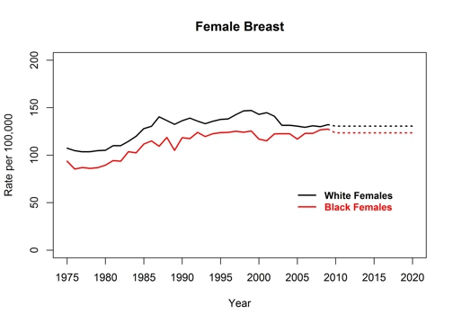
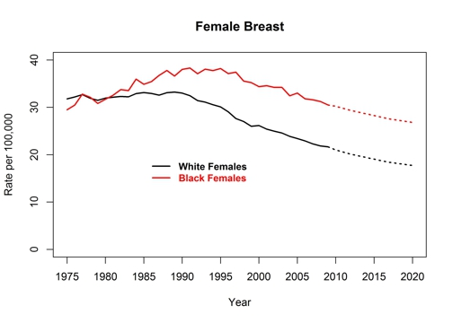
Breast Cancer Incidence and Death Rates
United States, 1975-2020
Division of Cancer Prevention and Control Centers for Disease Control and Prevention (2018).

Slide 6

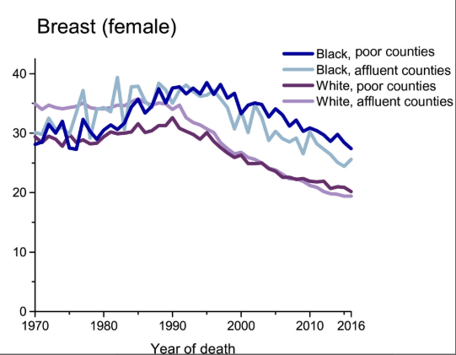
Cancer Mortality Rates by County-Level Poverty, United States, 1970-2016
Cancer Mortality Rates by County‐Level Poverty, United States, 1970 to 2016. Rates are per 100,000 population and are age adjusted to the 2000 US standard population. County‐level poverty was derived from the 2012 to 2016 American Community Survey. “Poor” and “affluent” refer to extreme county‐level poverty categories: 21.18% to 53.95% and 1.81% to 10.84%, respectively.
Siegel, R.L., et al. (2019). CA: A Cancer Journal for Clinicians.

Slide 7
Multiple “Opportunities” for Disparities
Across the Cancer Care Continuum
BIOLOGIC
PROVIDER
SYSTEM
PATIENT
Prevention
Screening
Diagnosis
Treatment
Survivorship

Slide 8
Compared to White women, Black women are:
Less likely to:
More likely to:
have BRCA testing
receive mammogram screening
receive breast conserving surgery
receive breast reconstruction
have oncotype DX testing
complete chemotherapy
adhere to oral medications
experience social barriers to care
detect cancer by self exam
have delay after screening
have dose delays in chemo
have advanced stage at diagnosis
miss treatment appointments

Slide 9
The Problem: Care Delivery Disparities
Discovery
Development
Delivery
Critical disconnect between cancer discoveries and cancer care delivery to all patients
Notes:
9
Threatens the realization for health equity

Slide 10
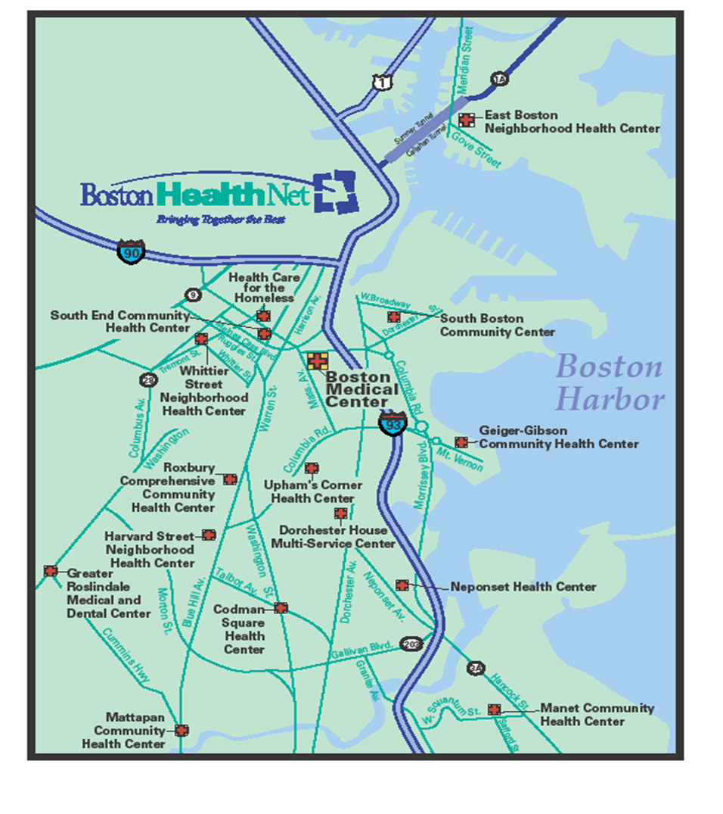


Boston Medical Center
Primary teaching hospital: Boston University
Public hospital serving inner-city with 13 federally qualified health centers
“Exceptional care without exception”

Slide 11


Our patient population is racially, culturally, and linguistically diverse—making the promotion of health equity a system imperative
~70% of our hospital patients identify as people of color
~50% of our hospital patients live at or below the federal poverty level
~50% of our Health Plan members have a mental health and/or substance use disorder
As a point of comparison, the low income patient population at other Boston-area academic medical centers is less than 15%

Slide 12



  Women’s Health Unit
  A DHHS Center of Excellence in Women’s Health
Primary-care based academic clinical research unit
Vision: Lead the nation in delivery of equitable,
comprehensive, coordinated and compassionate
women’s health care
Research
(Care delivery)
Training
&
Education
Clinic care
coordination
Community Engagement

Slide 13

The Generalist Lens
BIOLOGIC
PROVIDER
SYSTEM
PATIENT
Longitudinal relationships with individuals: patient/family
Front line view of the health system challenges to delivering quality care
Partner with public health and local community to understand local context
Unique position to understand and address care delivery disparities across the care continuum
The generalist

Slide 14
Mammography Screening Rates in Massachusetts
BRFSS MA Mammography rates among highest in the nation
85% of women aged 40-74 mammogram 2016-2018
No Black:White differences
Local data reveal certain populations remain at risk
Asian women*: 70%
Uninsured women*: 55%
Foreign-born Muslim*: <50%
Residency practices at BMC**: 55%
Health of Boston Report 2017
*Boston CHNA-CHIP Collaborative
**Schroff, Battaglia et al SGIM 2013.
Behavioral Risk Factor Surveillance System (BRFSS)

Slide 15
Days to Diagnosis After Abnormal Mammogram
*Battaglia et al Cancer 2010.
Notes:
Among 523 women with mammography abnormalities and 474 women with Pap test
abnormalities, >90% achieved diagnostic resolution within 12 months. Median time to resolution
was longer for Pap test than for mammography abnormalities (85 versus 27 days). Site of care, rather
than any sociodemographic characteristic of individuals, including race/ethnicity, was the only
significant predictor of timely follow up for both mammogram and Pap test abnormalities.

Slide 16
Breast Cancer Care at BMC
EMR Chart review
Diagnosis: In 2005, 36% referrals for screening abnormality NEVER arrived for evaluation (Battaglia et al, Cancer 2007)
Treatment: ER+/PR+ Breast Cancer 2006-8
36% non-complaint initiation HT within 365 days
Non-complaint: non-white, non-US born
Longest delays related to social language, transportation, insurance, health literacy (Crowley, Battaglia et al, J Onc Practice, 2014)

Slide 17
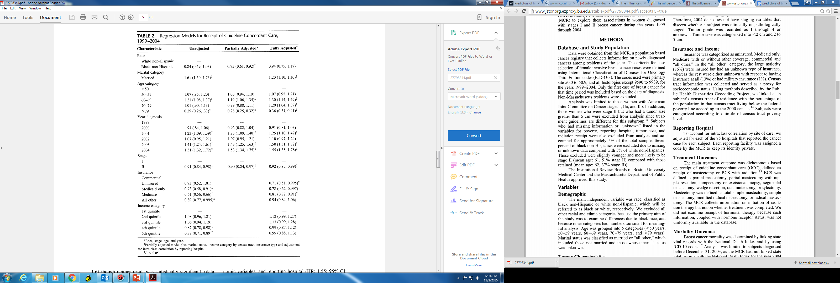
MA Cancer Registry:
Black, non Hispanic women less likely to receive guideline concordant treatment;
mediated by
Insurance status and Income
Berz, J. P., Johnston, K., Backus, B., Doros, G., Rose, A. J., Pierre, S., & Battaglia, T. A. (2009). Medical Care.
Notes:
: Blacks were less likely to receive GCC after adjusting for age and clinical variables (OR: 0.75; 95% CI: 0.61, 0.92). Marital status and insurance were predictors of receipt of GCC. After adjustment for all covariates, there were no longer significant differences between black and white women regarding the receipt of GCC. Nevertheless, black women were more likely to die of early-stage breast cancer than white women after adjusting for clinical, treatment, socioeconomic variables, and reporting hospital (HR: 1.6; 95% CI: 1.1–2.1).
Conclusions: Socioeconomic factors are mediators of racial differences in treatment outcomes. Significant racial differences exist in disease-specific mortality for women with early-stage breast cancer. Attention to reducing socioeconomic barriers to care may influence racial differences in breast cancer treatment and mortality.

Slide 18
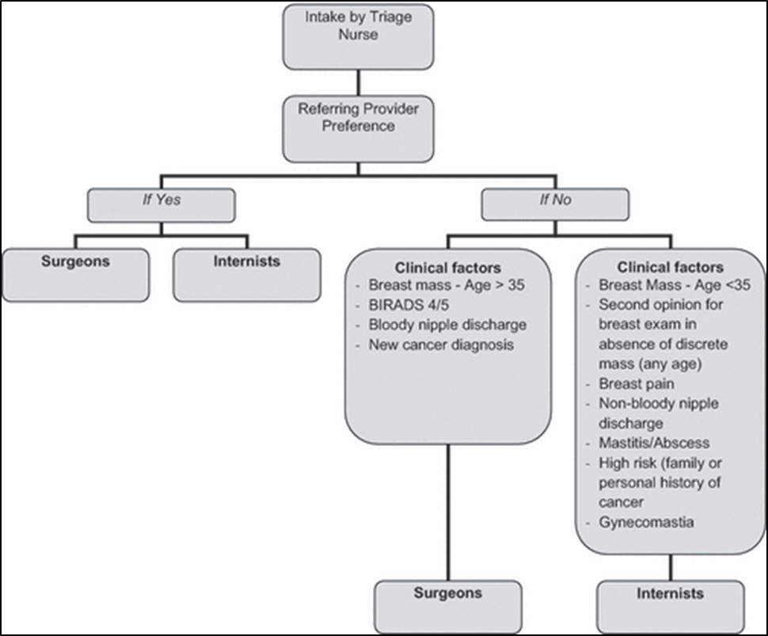
The Addition of Internists to Breast Practice
Multi-disciplinary practice
  Primary care
  Surgical oncology
  Radiology
  Cyto-pathology
Triage system
  Low Risk = medical providers
  High Risk = surgical providers
Services Provided Concurrently
Battaglia, T.A., Howard, M.B., Kavanah, M., Prout, M.N., Chapman, C., David, M.M., McKinney, R., Kronman, A., Dumont, T., Freund, K.M. (2011). The Breast Journal.

Slide 19
Pilot Patient Navigation Intervention
Patient Navigation (culturally congruent lay health worker) guided by principles of Care Management:
    Identify Case
    Identify individual barriers to care
    Design and implement care plan
    Long term tracking
Timely Follow-Up = arrival to diagnostic appointment within 120 days from referral

Slide 20
Timely Follow-Up (N=1,391)
Pre-Intervention | 64%
Intervention | 79%
p <0.0001
Women in Intervention group had 39% greater odds of having timely follow-up
Battaglia, Roloff, Posner, Freund. Cancer 2007.

Slide 21
Phillips et al. JGIM. (2010)

Slide 22
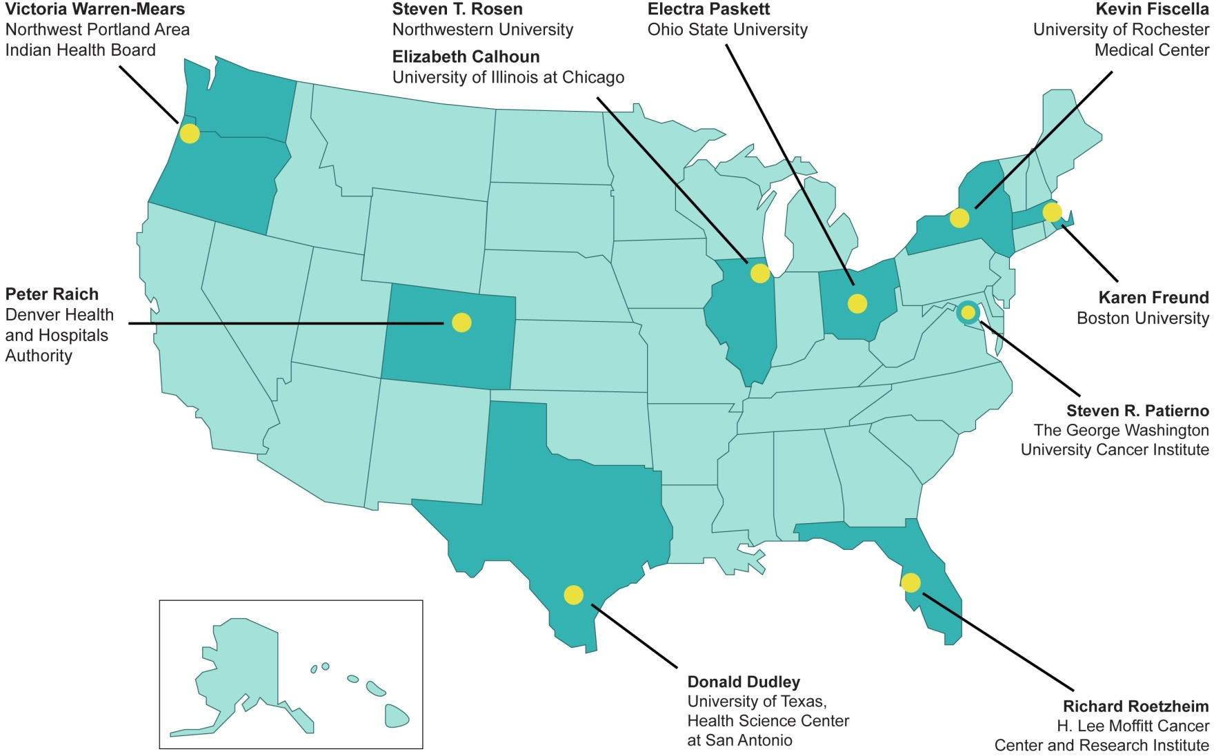

Patient Navigation Research Program (PNRP)
Notes:
22

Slide 23
PNRP Main Questions
Will navigated patients…
Receive timelier, definitive resolution following an abnormal finding?
Receive timelier treatments following a positive diagnosis?
Improve their satisfaction with the health care system experience?
Notes:
23

Slide 24
PNRP Methods
Breast, Cervical, Colorectal or Prostate
  Screening abnormality
  New cancer diagnosis
% complete diagnostic care in 365 days
Kaplan Meier survival curve estimate timely care
Adjusted Hazards Ratio (aHR) > 1.0 more timely care
Meta-analysis
Notes:
In order to address both the time to diagnostic resolution and the censoring for lack of ever reaching resolution we developed Kaplan-Meier survival curves and proportional hazards regression models to examine the effect of patient navigation on time to definitive diagnosis. The Kaplan Meier curves and hazards ratios were calculated separately for breast and cervical cancer screening abnormalities. The adjusted Hazards Ratios for the proportional hazards models. where the hazard ratio greater than 1.0 indicates that patient navigation is associated with a greater likelihood of diagnostic resolution.

Slide 25
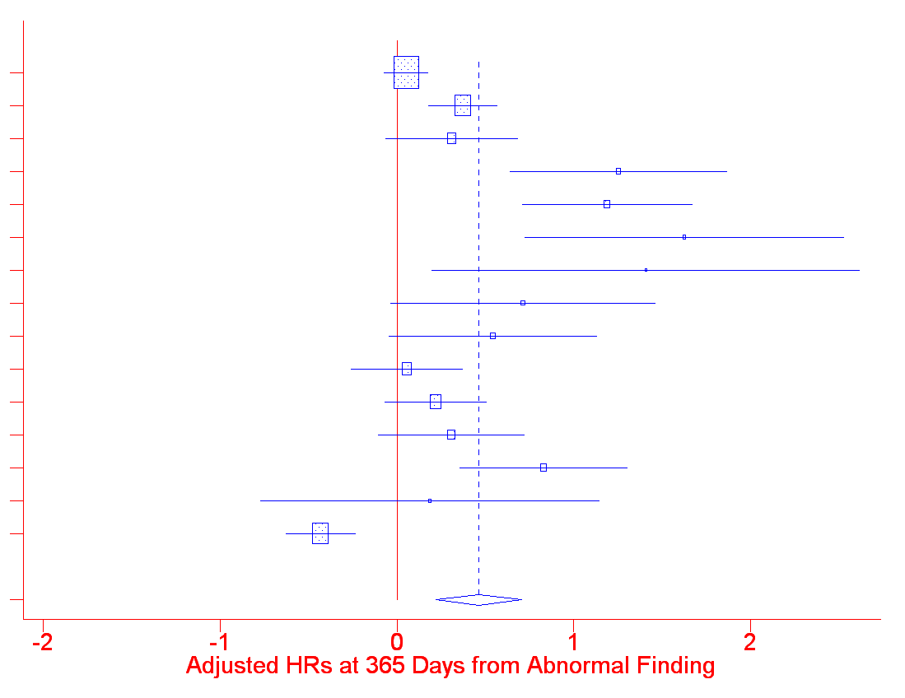
Meta-Analysis: Diagnostic Resolution at 365 Days
A breast
A cervix
B prostate
B breast
B cervix
C breast
C colorectal
C prostate
D breast
D cervix
E breast
E cervix
F breast
F colorectal
G breast
ALL
0.3
0.5
1
2
3
aHR = 1.4 (95% CI 1.2 – 1.7)

Slide 26
Adjusted Odds Ratios for Treatment Measures
Adjusted for age, race, insurance, marital status and study design
Quality Measures | aOR | 95 % CI | P value
Hormone Therapy | 1.78 | (1.22, 2.57) | 0.002
Radiation Therapy post Lumpectomy | 1.12 | (0.70, 1.79) | 0.643
Chemotherapy | 0.48 | (0.24, 0.95) | 0.035
Ko NY, Darnell JS, Calhoun E, Freund KM, Wells KJ, Shapiro CL, Dudley DJ,Patierno SR, Fiscella K, Raich P, Battaglia TA. Journal of Clinical Oncology. (2016)

Slide 27
Type of Barriers Matter
Notes:
Those with one barrier in the other barrier category had less timely resolution than those with no barriers (p=0.010). Those with two or more barriers including a social service barrier had a significantly longer time to resolution than those with no barrier (p<0.001), those with one other barrier (p=0.001), and those with two or more other barriers (p=0.014).

Slide 28
Navigator Activities Matter
Task/Network | Patient | Provider | Non-Clinical Staff | Support | EMR
Navigate with specific pt | YES
Facilitate for specific pt |  | YES | YES | YES
Maintain system for all |  |  |  |  | X
Document/ Review |  |  |  |  | X
Notes:
28
Define attributes of the work of patient navigators
Describe variation in navigation
Develop an evaluation instrument for observing navigator work that produces valid, reliable data across sites
Use this instrument to define and compare across sites and programs
*leveraged funds through the Avon foundation

Slide 29
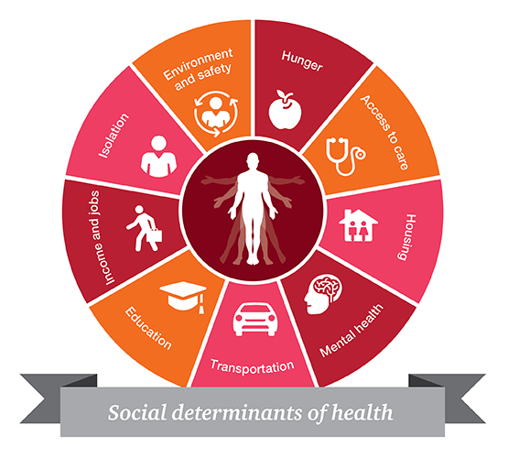
Cancer is Not Always the Worst Problem for our Patients: Social Determinants of Health
Notes:
Besides the fact that a lot of the innovative care is inaccessible, why is it inaccessible? Barriers to care = SDOH
Break down between discoveries and deliveries; and in deliveries

Slide 30

“Socio-legal” Barriers to Care at BMC
Patient survey: “Over the past two weeks I have been concerned about…”
  Income Supports
  Housing
  Education/Employment
  Legal Status
  Personal and Family Stability & Safety
104 respondents seeking cancer care
80 (77%) reported 1 or more concerns
Ko, Battaglia, et al. (2016)

Slide 31
Project SUPPORT*
Hypothesis: Among newly diagnosed cancer patients, patient navigation enhanced with legal advocacy to address socio-legal barriers will improve clinical and patient reported outcomes
Randomized Comparative Effectiveness Trial at BMC
Outcomes: time to first treatment, satisfaction, cancer needs
*PCORI and American Cancer Society

Slide 32
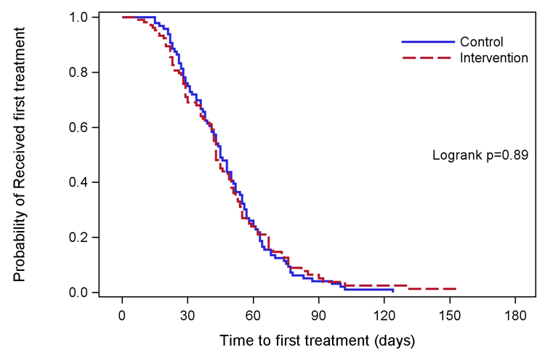
Kaplan-Meier Plot for time to first treatment (n=201)

Slide 33
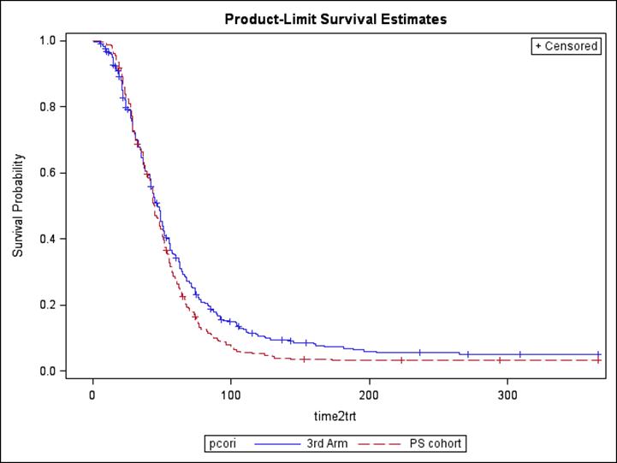
Project SUPPORT vs. “Third” Arm
Adjusted OR
2.79 (1.52, 5.13)

Slide 34
Black:White disparities in breast cancer mortality
Across the 50 largest cities in the U.S
Race-specific breast cancer mortality rates
Rate ratios between 1990-1994 (T1) and 2005-2009 (T2)
35 cities increase in Black:White rate ratio
Increase largely because White rates improved substantially
Boston had the fifth-highest rate ratio: 1.49; 95% CI: (1.18, 1.88)
1710 excess Black deaths annually, about 5 each day
Hunt, Whitman, and Hurlbert (2014). Increasing Black:White disparities in breast cancer mortality in the 50 largest cities in the United States. Cancer Epidemiology.
Notes:
Numerator data from national death files
Population-based denominators from the U.S. Census Bureau
Between 1990-1994 (T1) and 2005-2009 (T2), in Boston:
T2:T1 rate ratio of cancer mortality for Black women: 0.90
T2:T1 rate ratio of cancer mortality for White women: 0.57
*Where Black = non-Hispanic Black and White = non-Hispanic White

Slide 35

The Boston Breast Cancer Equity Coalition
Est. in 2014 in response to Hunt article
Multidisciplinary stakeholders: public health agencies, academic institutions, providers, patients, advocates, policy makers
Mission: Develop city-wide solutions to eliminate inequities in breast cancer outcomes
Local care delivery data: disproportionate treatment delays, transfers in care among the most vulnerable women
www.bostonbcec.org

Slide 36
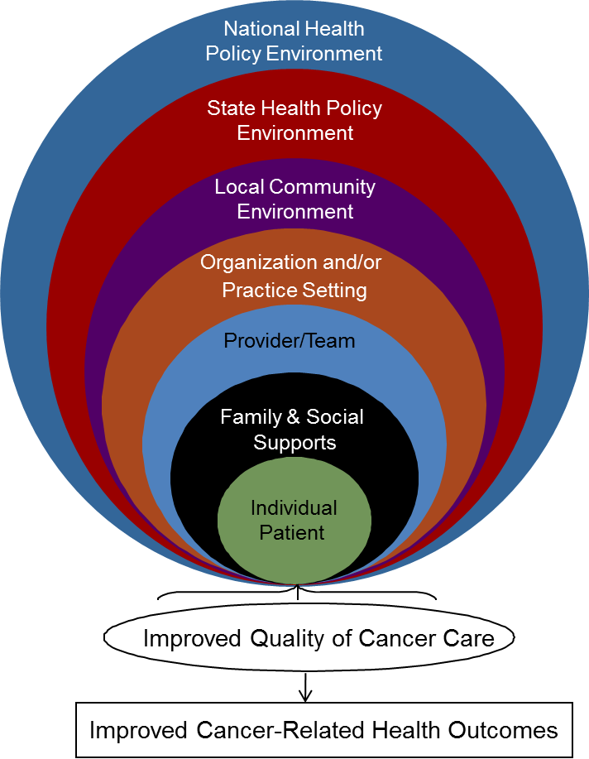
Boston Breast Cancer Equity Coalition identified challenges to Achieving Breast Cancer Equity
Health System level
  Lack of tracking systems for at risk women
  Fragmentation of oncology services
Provider/team level
  Lack of defined roles in ‘navigation’ process
  Communication between providers and navigators
Patient level
  Social Needs (financial, housing, employment,
  transportation, language, cultural)

Slide 37
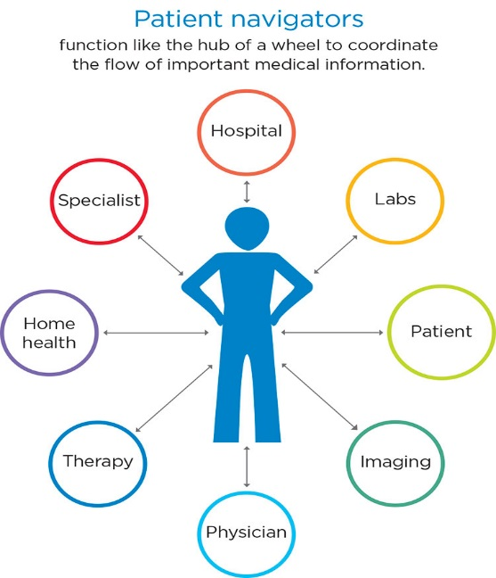
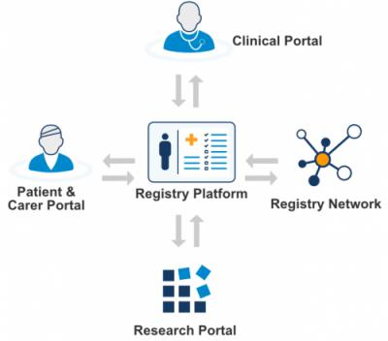
Research Gap: Evidence-based strategies for coordinating breast cancer care delivery are not systematically implemented within or across hospitals
Real-time Patient Registry population management
Health System level
Patient Navigation Services coordinate care delivery
Patient level
Provider/Team level
Health system level
Screening (and referral) interpersonal barriers to care
Patient Level
Health system level

Slide 38







TRIP*: Addressing disparities together
Tracy Battaglia, MD MPH | Karen Freund, MD MPH | Jennifer Haas, MD MPH | Stephenie Lemon, PhD
Boston
Patient Navigator Network
Boston
Patient Navigator Network
Clinical
Advisory
Panel
Funded by:
*NIH/NCATS U01TR002070

Slide 39






TRIP: The Research Question
“Can we systematically implement evidence-based coordination of care across the city of Boston to reduce delays in treatment and reduce disparities?”
“Can we systematically implement evidence-based coordination of care across the city of Boston to reduce delays for the most vulnerable women?”

Slide 40

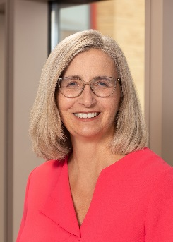

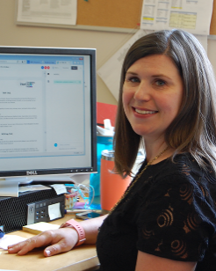


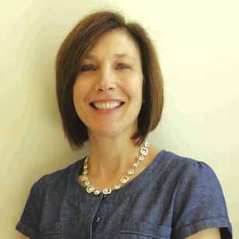
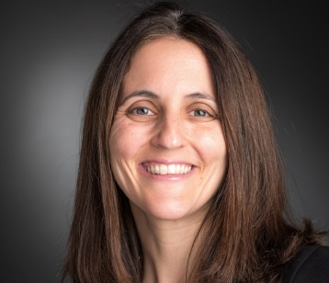
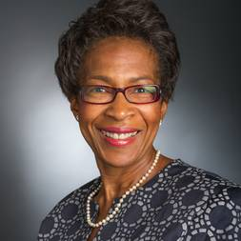
The TRIP Consortium
Principal Investigators
Tracy Battaglia, MD MPH
Boston Medical Center
Jennifer Haas, MD MSPH
Mass General Hospital
Karen M. Freund, MD MPH
Tufts Medical Center
Stephenie Lemon, PhD
UMass Medical Center
Co-Investigators
Boston Breast Cancer Equity Coalition
Amy LeClair, PhD MPhil
Tufts Medical Center
Cheryl Clark, MD ScD
Brigham and Women’s
Hospital
Christine Gunn, PhD
Boston Medical Center
Sharon Bak, MPH
Boston Medical Center
Rachel Freedman, MD MPH
Dana-Farber
Cancer Institute
Karen Burns White, MS
Dana-Farber
Cancer Institute
Notes:
Pictures, no words

Slide 41
Research Methods
Community-engaged implementation science: Integrating evidence-based interventions in partnership with key stakeholders
Pragmatic clinical trial: Cluster stepped wedge study design allows for rolling out iteratively in real life practice settings
Type 1 hybrid clinical effectiveness-implementation trial:
  Clinical outcomes: time to initiation of treatment; quality of care
  Implementation outcomes: acceptability, adoption, fidelity to protocol, penetration, sustainability, and cost

Slide 42

Who is our target population?
Adult female breast cancer
Greater Boston area (25 miles)
Have one or more risk factors for experiencing delays in care:
  Black
  Hispanic/Latina
  Non-English preferred language
  Uninsured or public insurance

Slide 43
Accomplishments (2017-2020)
Formative work with stakeholders
Clinical Advisory Panel created Patient Navigation Protocol
REDCap Registry and Aunt Bertha platforms built with input from providers and navigators
Rolled out TRIP intervention to 6 hospital sites
Expanded ZIP Code Eligibility
Started Implementation Data Collection
Disseminated TRIP Methods and Lessons
Over 2 years of enrolling patients and over 300 patients navigated!

Slide 44
Where are we now?
 | Aug – Dec 2018 |  |  | 2019 |  |  |  |  |  | 2020
BWFH
BIDMC
TMC
BMC
MGH
DFCI
Key
Highlights
7 TRIP navigators
309 patients navigated to date!
TRIP navigation
Site paused or closed
November 2021
end of enrollment

Slide 45
TRIP Enrollment
Demographics of On-Study Patients (n=295)
Race | White | 54 (18%)
 | Black | 136 (46%)
 | Asian | 40 (14%)
 | Other Race | 72 (24%)
Ethnicity | Hispanic | 89 (30%)
 | Non-Hispanic | 206 (70%)
Preferred Language | English Speaking | 140 (47%)
 | Non-English Speaking | 155 (53%)
Insurance Status | Private Insurance | 103 (35%)
 | Medicare | 54 (18%)
 | Medicaid or Uninsured | 154 (52%)
 | Other Insurance | 8 (3%)
ZIP Code | Boston Patients | 207 (70%)
 | Greater Boston Patients | 88 (30%)
Data from 9/1/2018 to 2/1/2021
Patients can select more than one racial identity and have more than one insurance
Notes:
Simplify?

Slide 46
Health-Related Social Needs
Characteristic | Response | Percentage of on-study patients at intake (n=295)
Number of Social Needs | No needs reported | 85 (29%)
 | 1 need identified | 50 (17%)
 | 2+ needs identified | 51 (17%)
 | Incomplete/Missing assessment | 109 (37%)
Top Domains of Need
Food (28%)
Employment (21%)
Utilities (16%)
Data from 9/1/2018 to 2/1/2021
Only includes patients who have a recorded initial social needs assessment
Notes:
Top domains of need, n= 186 (people with no needs reported + people with 1 need + people with 2 or more needs) = 186

Slide 47
TRIP Challenges 2019-2020
Health System Navigation Challenges:
  Tension for change, unique fragmented workflows
  Navigator turnover
  Competing navigation protocols based on other funding streams
  Multiple complex data systems that are not integrated
Social Needs and Access to Resources
  37% of enrolled women don’t complete baseline social needs assessment
  Hard to “close the loop” and know if patient could access resource

Slide 48
COVID-19: 1 year since start of pandemic
Competing demands for our clinical partners
Several navigators furloughed or redeployed to COVID-19 related duties
Learning and coordinating telehealth was challenging for patients and navigators
Patients fearful of appointments, experiencing loneliness and psycho-social needs
Resources are vulnerable
Need to invest in Equity driven initiatives during times of normalcy, so that they are in place during times of crisis

Slide 49
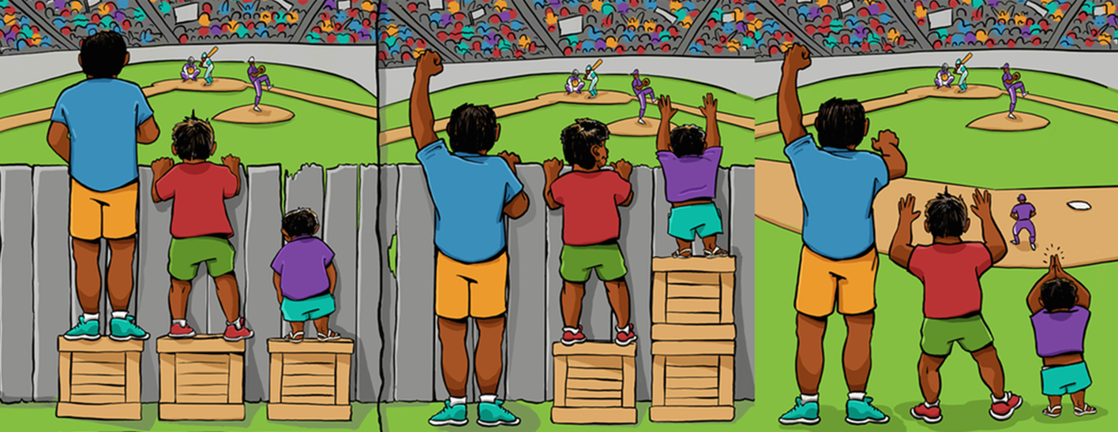
Move beyond addressing filling gaps towards true equity
Equality
Filling Gaps
True Equity
Equal Treatment:
-Assumption that all will benefit
-Starting point for many of our patients
Is different
Equitable Treatment:
Everyone given different supports to provide access. Filling gaps (often temporarily)
Equity: All have access without supports needed. Root cause of inequity addressed.
Structural barrier removed.
Slide from Dr. Thea James, Boston Medical Center

Slide 50
What is health equity?
= the assurance of the condition of optimal health for all people
- when health disparities are eliminated, health equity is achieved
Achieving Health Equity requires 3 things:
  valuing all individuals and populations equally
  recognizing and rectifying historical injustice
  providing resources based on need
Camera Jones, MD, MPH, PhD. Achieving Behavioral Health Equity for Children, Families, and Communities: Proceedings of a Workshop. National Academies Press, 2019.

Slide 51
How to apply a health equity lens to research
focus on identifying and understanding the root cause or inequity
  who is advantaged/disadvantaged?
  what are systems/structural reasons for inequity?
  how might our approach improve/perpetuate disparities?
Incorporate these issues into the research approach

Slide 52

look through a lens of race, power and poverty to understand the conditions that lead to inequity

Slide 53
What is Community Engaged Research (CEnR)?
Translational research to develop, implement, and disseminate effective interventions across diverse communities through strategies to:
redress power imbalances
facilitate mutual benefit among community and academic partners
promote reciprocal knowledge translation
Incorporate community theories into the research
Wallerstein and Duran. AJPH Supplement 1, 2010, Vol 100, S1
Community-Based Participatory Research Contributions to Intervention Research: The intersection of Science and Practice to Improve Health Equity

Slide 54
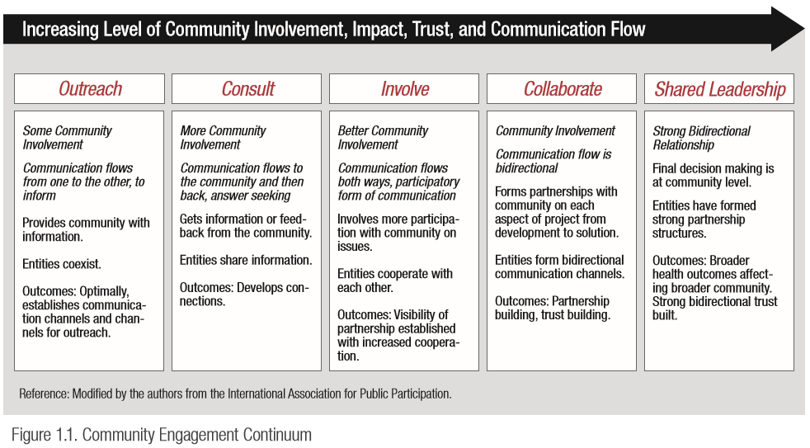

Slide 55
Community Engagement Competencies for Researchers
Perceived value of Community Engagement
Introspection & openness
Knowledge of community characteristics
Appreciation for stakeholders’ experience
Preparing for collaborative decision making
Collaborative planning
Communication effectiveness
Equitable distribution of resources & credit
Sustaining the partnership
*Shea et al., 2017
55
Notes:
Of note we have been referring to the 7 initial member as at large members.

Slide 56
How do we redefine success?
train researchers in CE competencies
leverage our power/privilege as providers/researchers to make space for and support community leadership
include voices of those most experiencing inequity in planning, conduct and dissemination of research
share power and resources
develop long term, trusting community-academic partnerships
co-learn with our partners

Slide 57
Possible Engagement Strategies
Fundamentally change the research process:
Informing through media
Listening through storytelling, town halls, surveys
Consulting with community members using focus groups, interviews
Involving through Community Advisory Boards
Collaborating with increasing levels of community involvement in every study
Sharing leadership, resources and decision-making

Slide 58
Final Thoughts
Disparities in cancer mortality are pervasive and not improving
New and improved treatments won’t do anything if we can’t get them to all patients
The generalist has a key role in addressing the multiple layers of the complex health care system
Meaningfully engaging ALL stakeholders in solutions are necessary to achieve equity
Don’t be afraid to let your own experiences drive your approach; we are all experts in our lived experience….

Slide 59


