Slide 1
Translating Research Into Practice (TRIP)
Tracy A Battaglia, MD MPH
May 5, 2021
Notes:
Tumor board research presentation (April 7, 5-5:30 PM)
Overview, update, future directions
Importance of follow-up assessments and role of medical oncologists
Approx. 15 minutes slides, 15 minutes discussions

Slide 2
Black:White disparities in breast cancer mortality
Across the 50 largest cities in the U.S
Race-specific breast cancer mortality rates
Rate ratios between 1990-1994 (T1) and 2005-2009 (T2)
35 cities increase in Black:White rate ratio
Increase largely because White rates improved substantially
Boston had the fifth-highest rate ratio: 1.49; 95% CI: (1.18, 1.88)
1710 excess Black deaths annually, about 5 each day
Hunt, Whitman, and Hurlbert (2014). Increasing Black:White disparities in breast cancer mortality in the 50 largest cities in the United States. Cancer Epidemiology.
Notes:
Numerator data from national death files
Population-based denominators from the U.S. Census Bureau
Between 1990-1994 (T1) and 2005-2009 (T2), in Boston:
T2:T1 rate ratio of cancer mortality for Black women: 0.90
T2:T1 rate ratio of cancer mortality for White women: 0.57
*Where Black = non-Hispanic Black and White = non-Hispanic White

Slide 3
The Boston Breast Cancer Equity Coalition
Est. in 2014 in response to Hunt article
Multidisciplinary stakeholders: public health agencies, academic institutions, providers, patients, advocates, policy makers
Mission: Develop city-wide solutions to eliminate inequities in breast cancer outcomes
Local care delivery data: disproportionate treatment delays, transfers in care among the most vulnerable women
www.bostonbcec.org

Slide 4
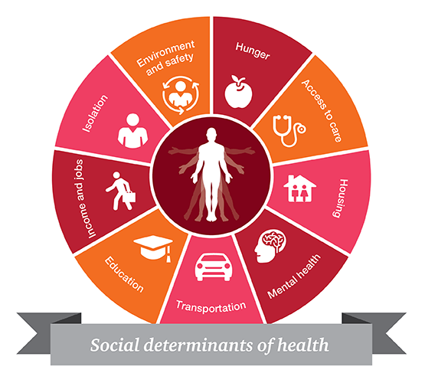
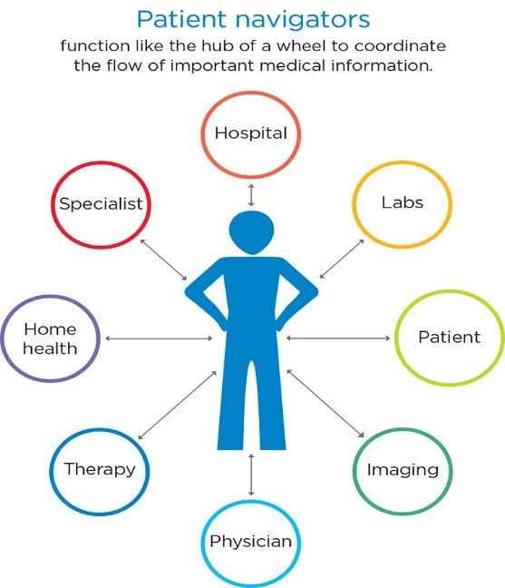
Research Gap: Evidence-based strategies for coordinating breast cancer care delivery are not systematically implemented within or across hospitals
Real-time Patient Registry population management
Health System level
Patient Navigation Services coordinate care delivery
Patient level
Provider/Team level
Health system level
Screening (and referral) interpersonal barriers to care
Patient Level
Health system level

Slide 5
Translating Research Into Practice
National Center to Advance Translational Science
Collaborative Innovation Award between > 3 universities/CTSA programs
Disparities initiative
Community-driven research methods
$8.9 million NIH funded study (2017-2022)

Slide 6
TRIP*: Addressing disparities together
Tracy Battaglia, MD MPH | Karen Freund, MD MPH | Jennifer Haas, MD MPH | Stephenie Lemon, PhD
Boston Patient Navigator Network
Boston Patient Navigator Network
Clinical
Advisory
Panel
Funded by:
*NIH/NCATS U01TR002070

Slide 7
TRIP: The Research Question
“Can we systematically implement evidence-based patient navigation across the city of Boston to reduce delays in treatment and reduce disparities?”
“Can we systematically implement evidence-based coordination of care across the city of Boston to reduce delays for the most vulnerable women?”

Slide 8
Research Methods
Community-engaged implementation science: Integrating evidence-based interventions in partnership with key stakeholders
Pragmatic clinical trial: Radnomized, Cluster stepped wedge study design allows for rolling out iteratively in real life practice settings
Type 1 hybrid clinical effectiveness-implementation trial:
Clinical outcomes: time to initiation of treatment; quality of care
Implementation outcomes: acceptability, adoption, fidelity to protocol, penetration, sustainability, and cost

Slide 9
Stepped Wedge Study Design
 | Pre-TRIP | Year 1 |  |  | Year 2 |  |  |  | Year 3 |  |  |  | Year 4 |  |  |  | Year 5
Sites | 2016-17 | Sept-Nov 2017 | Dec 2017- Feb 2018 | March-May 2018 | June-Aug 2018 | Sept-Nov 2018 | Dec 2018- Feb 2019 | March – May 2019 | June – Aug 2019 | Sept – Nov 2019 | Dec 2019 –Feb 2020 | March – May 2020 | June – Aug 2020 | Sept –Nov 2020 | Dec 2020- Feb 2021 | March – May 2021 | June – Aug 2021 | Sept –Nov 2021
1 |  |  |  |  | BW-Faulkner Hospital
2 |  |  |  |  |  | Beth Israel Deaconess Medical Center
3 |  |  |  |  |  |  | Tufts Medical Center
4 |  |  |  |  |  |  |  | Boston Medical Center
5 |  |  |  |  |  |  |  |  | Mass. General Hospital
6 |  |  |  |  |  |  |  |  |  | Dana-Farber

Slide 10
Who is our target population?
Adult female breast cancer
Greater Boston area (25 miles)
Have one or more risk factors for experiencing delays in care:
Black
Hispanic/Latina
Non-English preferred language
Uninsured or public insurance

Slide 11
Who is our target population?
Historical Control | Intervention
Date period: 8/6/2016 – 8/24/2019* Target number: 571 (across all sites) 74 (BIDMC) | Date period: 8/6/2018 –11/25/2021 Target number: 589 (across all sites) 114 (BIDMC)
*3 month washout period between the end of historical control enrollment and intervention enrollment for each site

Slide 12
Intervention Components

Slide 13
11 Step Navigation Protocol
Identify eligible patients
Establish initial contact with patient
Establish frequency of routine ongoing contact
Identify logistic barriers or social needs (social needs assessment)
Ensure patient follows up with social needs referrals
Communicate with healthcare team
Complete 3 attempts to reach the patient
Follow up after a missed appointment
Manage patients lost to follow up
Track patients on a population level
Complete transitions in care/end of navigation

Slide 14
TRIP Navigation Principles
Navigation is a process not a person.
Navigation spans all departments involved in a patient’s care.
Patients should be proactively and systematically screened for social needs when they are diagnosed and when they change treatment modalities.

Slide 15
REDCap Shared Patient Registry

Slide 16
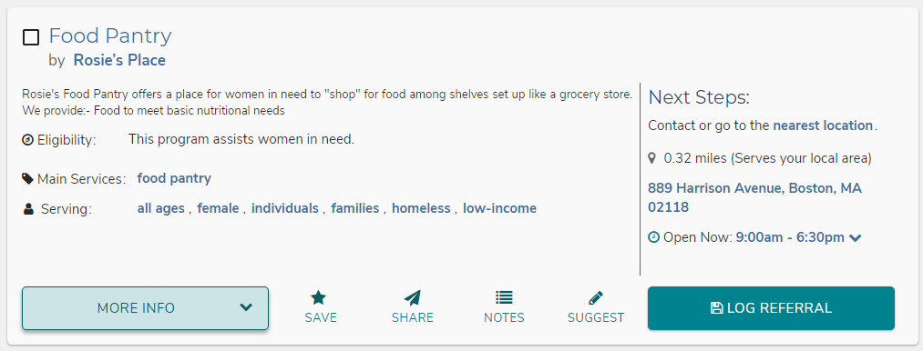
Aunt Bertha Social Needs Assessment and Referrals Platform
Domains:
Transportation
Food
Housing
Utilities
Paying for treatment
Employment
Continuing education
Legal
Phone service
Care taking

Slide 17
Accomplishments (2017-2021)
Formative work with stakeholders
Site Workflow mapping
Clinical Advisory Panel created Patient Navigation Protocol
Built the TRIP Navigator Network within the Boston Patient Navigator Network
REDCap Registry and Aunt Bertha platforms built with input from stakeholders
Rolled out TRIP intervention to 6 hospital sites
Expanded ZIP Code Eligibility
Started Implementation Data Collection
Disseminated TRIP Methods and Lessons to Chicago
Annual Stakeholder Meeting
Over 2 years of enrolling patients and over 300 patients navigated!

Slide 18
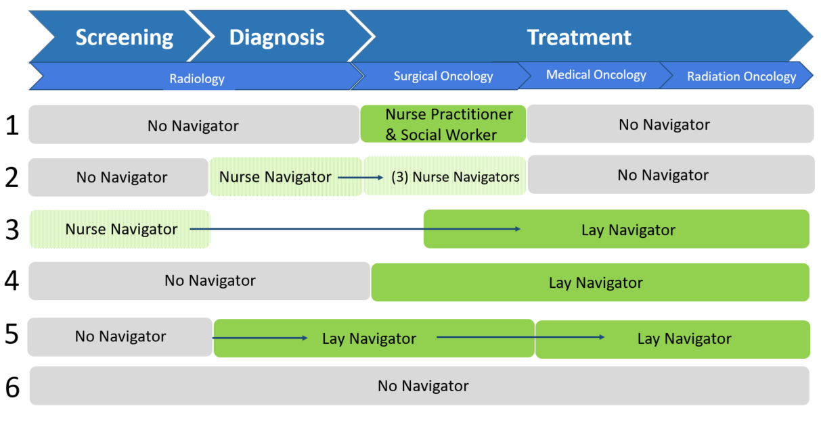
Pre-TRIP Workflows Across 6 Sites
Notes:
Arrows signify a hand off

Slide 19
BIDMC Workflow Map: Pre-TRIP
Radiology
Medical Oncology
Radiation Oncology
Surgical Oncology
Radiology Nurse Navigator navigates patient
Nurse Navigator completes social needs assessment with patient and collaborates with Social Work & Community Resource Specialists as needed
Nurse Navigators follow-up through post-op pathology as needed
Confirmed breast dx
Transfer to Med Onc
No patient navigator
Patient coordinator assumes responsibility for patient
Providers are crucial to continuity of care by previewing social needs assessment
No patient navigator
Staff RN assumes responsibility for patient
Transfer to Rad Onc

Slide 20
Where are we now?
 | Aug – Dec 2018 |  |  | 2019 |  |  |  |  |  | 2020
BWFH
BIDMC
TMC
BMC
MGH
DFCI
Aug – Dec 2018
2019
2020
2021
Key
Highlights
9 TRIP navigators
339 patients navigated as of April 5!
Now
End of
Enrollment
(Nov 21)
TRIP navigation
Site paused or closed
Notes:
Target enrollment by end: 589 intervention patients
Will do NCE starting June 2022

Slide 21
TRIP Enrollment
Demographics of On-Study Patients (9/1/2018 to 4/5/2021)
 |  | Cumulative Total (n = 339) | BIDMC (n = 80)
Race | White | 61 (18%) | 18 (23%)
 | Black | 161 (47%) | 34 (43%)
 | Asian | 45 (13%) | 17 (21%)
 | Other Race | 80 (24%) | 18 (23%)
Ethnicity | Hispanic | 99 (29%) | 18 (23%)
 | Non-Hispanic | 239 (71%) | 61 (77%)
Preferred Language | English Speaking | 158 (47%) | 35 (44%)
 | Non-English Speaking | 181 (53%) | 45 (56%)
Insurance Status | Private Insurance | 124 (37%) | 26 (33%)
 | Medicare | 62 (18%) | 16 (20%)
 | Medicaid or Uninsured | 171 (50%) | 45 (57%)
 | Other Insurance | 12 (4%) | 1 (1%)
ZIP Code | Boston Patients | 230 (68%) | 50 (63%)
 | Greater Boston Patients | 109 (32%) | 30 (37%)
Patients can select more than one racial identity and have more than one insurance

Slide 22
Initial Social Needs Assessment
Characteristic | Response | Percentage of on-study patients at intake (n=339)
Number of Social Needs | No needs reported | 90 (27%)
 | 1 need identified | 52 (15%)
 | 2+ needs identified | 55 (16%)
 | Incomplete/Missing assessment | 142 (42%)
Top Domains of Need
Food (20%)
Employment (28%)
Utilities (15%)
Data from 9/1/2018 to 4/5/2021
Notes:
BIDMC Initial SNA data:
No needs reported 16 (21%)
1 need identified 12 (15%)
2+ needs identified 21 (27%)
Incomplete/missing 29 (37%)

Slide 23
Follow-up Social Needs Assessment
Characteristic | Response | Percentage of on-study patients at intake (n=339)
Number of Social Needs | No needs reported | 23 (7%)
 | 1 need identified | 19 (6%)
 | 2+ needs identified | 18 (5%)
 | Incomplete/Missing assessment | 279 (82%)
Top Domains of Need
Food (23%)
Employment (31%)
Data from 9/1/2018 to 4/5/2021
Notes:
BIDMC Follow Up SNA data:
No needs reported 2 (3%)
1 need identified 2 (3%)
2+ needs identified 7 (9%)
Incomplete/missing 67 (85%)

Slide 24
TRIP Challenges (2019-2021)
Health System Challenges:
Tension for change
Unique fragmented workflows
Navigator turnover
Competing navigation protocols based on other funding systems
Social Needs and Access to Resources:
Challenge to integrate timely social needs assessments into navigator workflow
Navigators default to the “usual” resources
Hard to “close the loop” and know if patient could access resource
Data/Technical Challenges
Single IRB but different institutional perspectives
Data sharing agreements
Multiple complex data systems that are not integrated
Reducing the need for double data entry
Notes:
Add data challenges section

Slide 25
TRIP Challenges: COVID-19
Competing demands for our clinical partners
Several navigators furloughed or redeployed to COVID-19 related duties
Learning and coordinating telehealth challenging for patients and navigators
Patients fearful of appointments
Patients experiencing loneliness and psycho-social needs
Resources are vulnerable

Slide 26
TRIP Implementation Strategies
Convene clinical Champions in monthly Clinical Advisory Panel
Weekly site updates
Monthly monitoring tables
Navigator trainings and technical assistance
Monthly stakeholder newsletter
Quarterly BBCEC meetings
Annual Stakeholder meeting
Incorporated social needs assessment into pre-surgery intake
“Lay” navigator to support follow up social needs assessment

Slide 27
Final Thoughts
Successes
Collaboration across 4 CTSAs and 6 health systems
Stakeholder engagement
Navigators at all sites
Diverse population
Opportunities for collaboration
6 months of enrollment left
Rich study data
Future sustainability
Collaborating with the ACS Council of Advisors, Chicago CTSA and National Navigation Roundtable

