Slide 1
Translating Research Into Practice: In Pursuit of Breast Cancer Equity
Tracy A Battaglia MD MPH
Director, Women’s Health Unit
BMC Equity Innovation Forum
March 3, 2022
Notes:
Add in TRIP overview

Slide 2
Objectives
Describe how the delivery of high quality breast cancer care contributes to outcome disparities
Share the ‘story’ of and the preliminary findings from Translating Research Into Practice: A community-engaged, city-wide Implementation Study

Slide 3
“Personal” Disclosure
1990: Stage IV Hodgkins Lymphoma
White, professional: place of privilege
Did not share the same care experience as my patients
Career focus - understanding and addressing care differences for women historically marginalized
2018: Stage I ER-/PR-/Her2+ Breast Cancer
We have a long way to go to get to equity………

Slide 4
The Problem: Care Delivery Disparities*
Discovery
Development
Delivery
Critical disconnect between cancer discoveries and care delivery to all patients*
*2013 IOM Report: The Cancer Care Delivery System is in Crisis
Notes:
4
Threatens the realization for health equity

Slide 5
Women’s Health Unit A DHHS Center of Excellence in Women’s Health
Est 1989. Vision: Lead the nation in delivery of equitable,
comprehensive, coordinated and compassionate
women’s health care
1999-present: site for DPH Women’s Health Network
2001-2019: Avon Breast Health Initiative
2007-2012: NCI Patient Navigation Research Program
2012-present: Community Engagement Program, BU CTSI
https://ncihub.org/resources/1600/download/BMC_Patient_Navigation_Toolkit_-_Vol_1.pdf
Clinical Care
Training
Education
Research
Community Engagement

Slide 6
Compared to White women, Black women are:
Less likely to:
More likely to:
have BRCA testing
receive mammogram screening
receive breast conserving surgery
receive breast reconstruction
have oncotype DX testing
complete chemotherapy
adhere to oral medications
experience social barriers to care
detect cancer by self exam
have delays in diagnosis
have advanced stage at diagnosis
have dose delays in chemo
miss treatment appointments
Have premature mortality

Slide 7
2014: Disparities Breast Cancer Mortality Increasing*
50 largest US cities 1990 - 2009
35 cities increase in Black:White mortality rate ratio
Boston had the 5th highest increase: 1.49 (95% CI 1.18, 1.88)
Increase largely because White rates improved substantially
1,710 excess Black deaths annually
an average of about 5 each day.
*Hunt, Whitman, and Hurlbert (2014). Increasing Black:White disparities in breast cancer mortality
in the 50 largest cities in the United States. Cancer Epidemiology.
Notes:
Numerator data from national death files
Population-based denominators from the U.S. Census Bureau
*Where Black = non-Hispanic Black and White = non-Hispanic White

Slide 8
The Boston Breast Cancer Equity Coalition
Est. in 2014 in response to Hunt article
Multidisciplinary stakeholders: public health agencies, academic institutions, providers, patients, advocates, policy makers
How can a City replete with many of the top medical centers in the nation continue to tolerate such disparities??
Mission: Develop city-wide solutions to eliminate inequities in breast cancer outcomes
www.bostonbcec.org

Slide 9
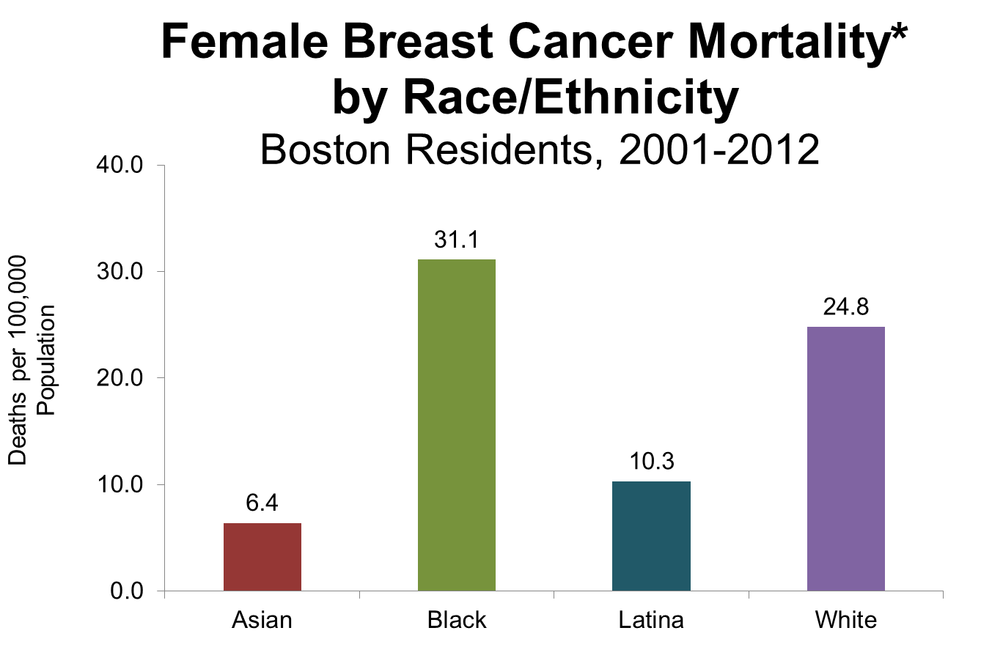
MA Registry Data: confirmed the disparity
*average annual (i.e., annualized 12-year) age-adjusted rates. B >A,L,W
NOTE: Death data for 2012 are preliminary and should be interpreted with caution. Until data are final, some changes in data values may occur during data quality processes.
DATA SOURCE: Boston Resident Deaths, Massachusetts Department of Public Health
DATA ANALYSIS: Boston Public Health Commission Research and Evaluation Office B:W+25 p<.01
Notes:
In the city of Boston inequities in breast cancer mortality have persisted among Black, non-Hispanic women compared to women of other racial/ethnic groups

Slide 10
Treatment Delays Lead to Disparities
BlackNH and Medicaid patients are 2-3x more likely to have delays in initiating treatment > 60 days
 | aOR (95% CI)*
Black NH vs White NH | 2.2 (1.6, 3.1)
Medicaid vs Private | 2.8 (1.8, 4.3)
MA Cancer registry data 2010-2014: Boston women with breast cancer stages 0-3
Notes:
In Boston,
Black non-Hispanic women have a mean time to first treatment of 54 days (SD 47.4) vs 41 days for White non-Hispanic women (SD 35.2)*

Slide 11
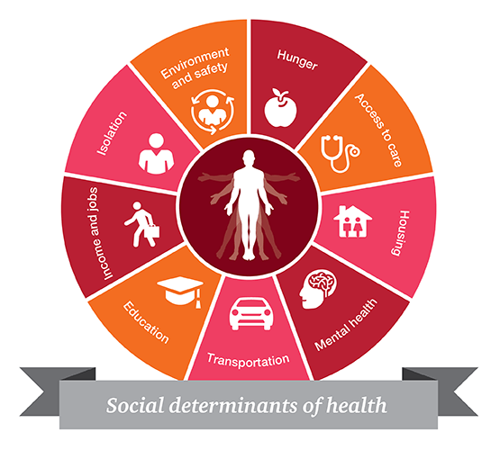
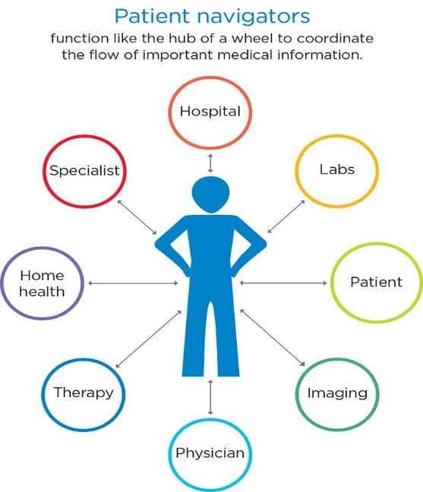
The Problem: Evidence-based strategies for combating delays do exist, but are not systematically implemented within or across hospitals
Patient Navigation to Guide and Support
Patient Registry to Track
at risk Population Over Time
Systematic screening to address Social Barriers to Care

Slide 12
City-Wide Collaboration
Research Leads
Local Academic Medical Centers
Notes:
Table 3
Remove new patients

Slide 13
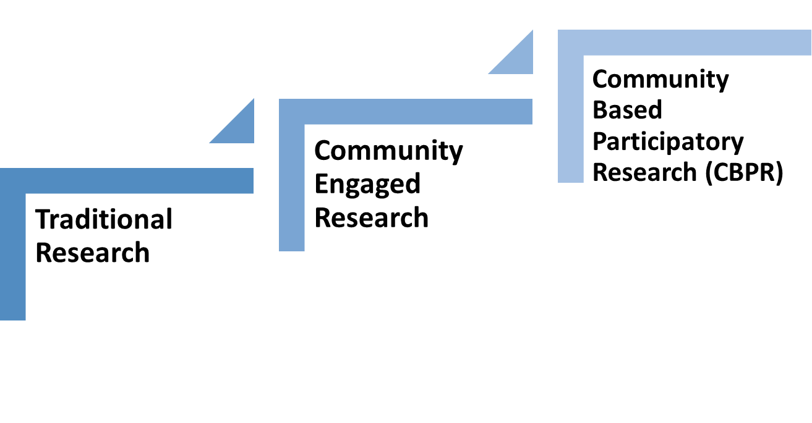
Community Engaged Research
Research approach that focuses on collaboration with key stakeholders
Characterized by: principles that guide research and relationships between communities and academic researchers
Increasingly recognized approach to address complex public health issues
Community stakeholders are partners in ALL aspects of the research process
Community stakeholder is involved in some meaningful way
Community member participates as a research subject
Notes:
Stakeholders: patients, family members, caregivers, community members & organizations as well as researchers, scientists and physicians.
Groups of people with similar affiliation:
Location: those living in the same city or neighborhood
Shared Special interest: access to fresh fruits and vegetables OR making their community safer
Similar situations: cancer survivors, have children with asthma, suffering from chronic pain

Slide 14
The Research Question
“Can we systematically implement evidence-based coordination of care across the city of Boston to reduce delays in care for women?”
“Can we systematically implement evidence-based coordination of care across the city of Boston to reduce delays for the most vulnerable women?”
Patient navigation network
(Provider/Care Teams)
Shared registry
(Health System)
Social needs assessment and referral
(Individual Pateint)

Slide 15
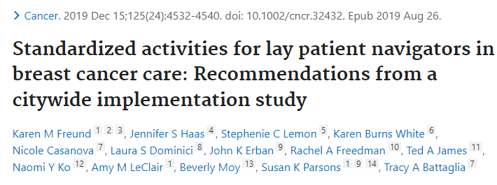
New Standard of Care Approach

Slide 16
Research Methods
Community-engaged implementation science: Integrating evidence-based interventions in partnership with key stakeholders
Type 1 hybrid clinical effectiveness-implementation trial:
Clinical outcomes: time to initiation of treatment; quality of care
Implementation outcomes: acceptability, adoption, fidelity to protocol, sustainability, and cost
Pragmatic clinical trial: Cluster stepped wedge study design allows for rolling out iteratively in real life practice settings

Slide 17
Stepped Wedge Study Design
 | Pre-TRIP | Year 1 | Year 2 |  |  |  | Year 3 |  | Year 4 | Year 5
1 |  |  | BW-Faulkner Hospital
2 |  |  |  | Beth Israel Deaconess Medical Center
3 |  |  |  |  | Tufts Medical Center
4 |  |  |  |  |  | Boston Medical Center
5 |  |  |  |  |  |  | Mass. General Hospital
6 |  |  |  |  |  |  |  | Dana-Farber Cancer Institute

Slide 18
Eligibility Criteria
All:
Age ≥ 18 years
Sex: Female
Diagnosis: Breast cancer
Lives within 25 mi of Boston
At least one:
Black and/or Hispanic/Latina
Preferred language is not English
Uninsured or on public insurance
AND

Slide 19
TRIP Study Participants (N=1,211)
 |  | Intervention (n=616) | Historical Control (n=595)
Age Category | <50 | 25% | 27%
 | 50-65 | 43% | 38%
 | >65 | 32% | 35%
Race | White Non-Hispanic | 12% | 17%
 | Black Non-Hispanic | 45% | 42%
 | Asian Non-Hispanic | 12% | 12%
 | Hispanic | 27% | 25%
 | Other Race | 3% | 1%
Language | English | 52% | 53%
 | Not English | 48% | 47%
Region | Boston | 62% | 65%
 | Greater Boston | 38% | 35%
Insurance | Private | 37% | 36%
 | Medicare | 16% | 18%
 | Medicaid | 45% | 44%
 | Uninsured | 1% | 2%
Data as of 11/30/2021
Notes:
Table 3
Remove new patients

Slide 20
Social Needs Assessments
Baseline
418/616 patients screened
Top 3 needs
Follow-up (3 month)
220/616 patients screened
Top 3 needs
Employment
25%
Food
15%
Utilities
10%
Employment
17%
Food
18%
Transportation
13%
Data as of 2/1/2022

Slide 21
Preliminary Implementation Data: Interviews and Field Observations
Barriers | Facilitators | Value Added
Competing demands partners (COVID) Relative priority of TRIP Tension for change related to scope of navigation Navigator turnover Incompatible data systems leading to duplication of effort | Compatibility with existing workflow Adapting protocol to existing workflow Continuous support and response to feedback Clinical Champions | Formalizing evidence-based navigation process Regional approach to care Communication across systems

Slide 22
Final Thoughts
Delivering high quality cancer care to ALL patients is necessary to achieve equity in outcomes
Community partnerships are necessary to address the complex challenges to equitable care delivery
The TRIP study provides a rigorous scientific approach to repairing the “disconnect” between discovery and delivery
Lessons learned form this Multi-level intervention will inform best practices (what works, what doesn’t work and why)
In a City replete with healthcare resources, BMC is leading the way to exceptional breast cancer care ☺

Slide 23
Questions?

Slide 24
Contact Us
To learn more about our program or
to request a consultation,
email the CE Program Manager, Dema Hakim (dkhakim@bu.edu).
To stay updated with our events and news, sign up for our mailing list
(Scan code to sign up)

