Slide 1
Translating Research Into Practice (TRIP): Best Practices for Integrating Social Needs Assessments
May 17, 2021
Notes:
~15 minutes total
Slides with:
Brief overview of TRIP
Best practices TRIP has developed to help users adopt Aunt Bertha (examples: workflow assessments, trainings especially bringing in an experienced “super user”, monitoring data)
Information TRIP used to help iterate and increase adoption at different sites
Discussion questions to open up a dialogue—share what’s been challenging for TRIP and ask other Collaborative members what they’ve done

Slide 2
TRIP*: Addressing disparities together
Tracy Battaglia, MD MPH | Karen Freund, MD MPH | Jennifer Haas, MD MPH | Stephenie Lemon, PhD
Boston Patient Navigator Network
Boston Patient Navigator Network
Clinical
Advisory
Panel
Funded by:
*NIH/NCATS U01TR002070
Notes:
National Center to Advance Translational Science
Collaborative Innovation Award between > 3 universities/CTSA programs
Disparities initiative
Community-driven research methods
$8.9 million NIH funded study (2017-2022)

Slide 3
TRIP: The Research Question
“Can we systematically implement evidence-based patient navigation across the city of Boston to reduce delays in treatment and reduce disparities?”
“Can we systematically implement evidence-based coordination of care across the city of Boston to reduce delays for the most vulnerable women?”

Slide 4
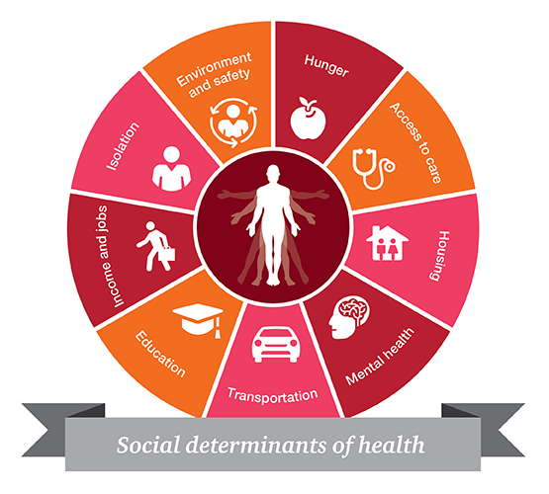
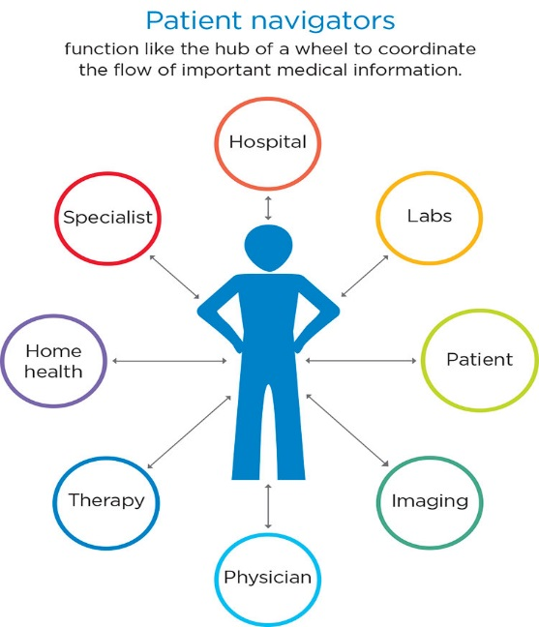
TRIP Intervention Components
Real-time Patient Registry
Patient Navigation Services
Systematic Social Needs Assessment
(Aunt Bertha)

Slide 5
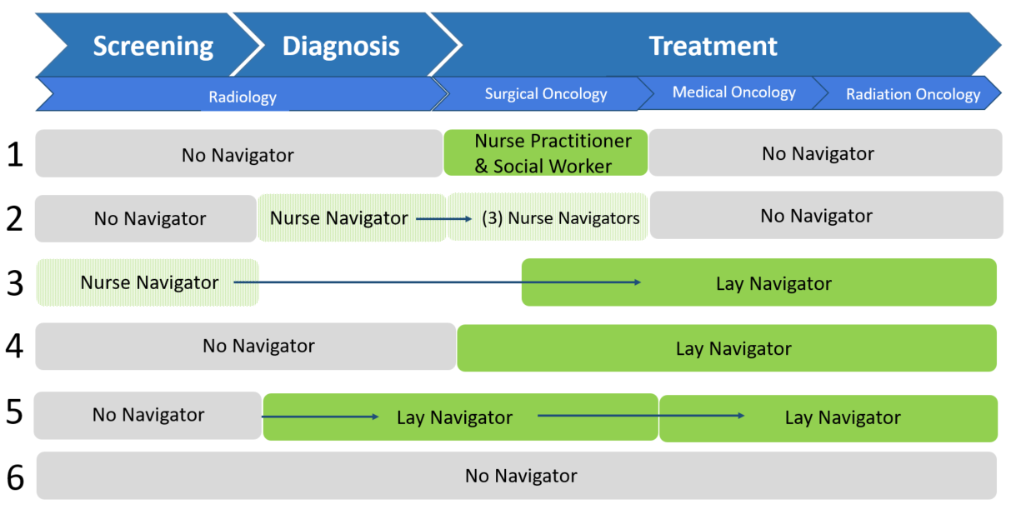
Pre-TRIP Workflows Across 6 Sites
Notes:
Arrows signify a hand off

Slide 6
Best Practices for Integrating Social Needs Assessments
Baseline workflow assessment at each site
1-hr meeting
Provided trainings and support to increase adoption
Schedule: 2 hour training at startup, 3 1-hr check-ins over first 9 months
Brought in a “super user”
Skills practice (Empathetic Inquiry)
Monitoring and data feedback
Monthly review of platform usage data
Adapted Aunt Bertha functions to each site
Notes:
Baseline workflow assessment at each site
Adapt social needs screening process for existing workflows
Provided trainings and support to increase adoption
Navigator network meetings and site visits
Brought in “super user”
Monitoring and data feedback
Iteratively created monitoring reports (time intensive at first!)
Adapted Aunt Bertha functions for each site
Only at BMC use THRIVE and have outbound referrals turned on

Slide 7
Navigator Feedback
Facilitator: Language capability
“That's one really wonderful resource for us...now, we can just find out the social resource and provide a patient directly. But on the other hand, it's not really helpful for the patient who not speak English, because all the information provide to the patient is English, right?”
Barrier: Double data entry
“I think the only challenging part is remembering to use Aunt Bertha or to document things. Because it is kind of difficult to think, when I'm already documenting in the EMR or Epic, I fill out a flow sheet, I write out all these different things.”
Barrier: Concern about patient acceptability
“My feeling is sometimes patients, I mean this is just my own bias, I think that they are embarrassed sometimes that we're asking them these questions and here I am, I speak English and I'm working and they probably realize that or they think that I have health insurance and everything else.”

Slide 8
Continued Challenges with Adoption
Platform | Response | Patients eligible only for Aunt Bertha SNAs (n=172)
Aunt Bertha | Completed Initial SNA | 100 (58%)
 | Completed Follow Up SNA | 21 (12%)
 |  | Patients eligible for THRIVE SNAs (n=167)
THRIVE | Completed Initial SNA | 164 (98%)
 | Completed Follow Up SNA | 32 (19%)*
Data from 9/1/2018 to 4/5/2021
*THRIVE numbers low due to data access problem.
Navigator uptake remains a challenge!
Notes:
# THRIVE initial SNAs reported on REDCap: 164 (98%)
Temporarily missing THRIVE data due to a change in the sites’ reporting system

Slide 9
Lessons Learned
Beneficial to learn how to integrate into already existing workflow
Find ways to reduce double data entry
Providing support, trainings (technical and empathetic inquiry), check-ins is beneficial
Monitoring data, sharing back data with our sites, engaging our community partners and site members in training others

Slide 10
Discussion Questions
What is the role of leadership and setting expectations around completing social needs assessments at your institution?
Who at your institution is conducting the social needs assessment?
Primary care? Specialty? All?
Providers? Support staff? All?
Has your institution integrated a social needs screening platform into your EHR?
What does integration mean in terms of provider access to data?
Have you collected patient feedback around their experience receiving the social needs assessment?

