Slide 1
Implementation of social needs screening for newly diagnosed breast cancer patients: Evaluation of facilitators and barriers to successful screening.
Stephenie Lemon, Amy LeClair, Deborah Amburgey, Erika Christianson, Cheryl Clark, Jennifer Haas, Karen Freund, Tracy Battaglia

Slide 2
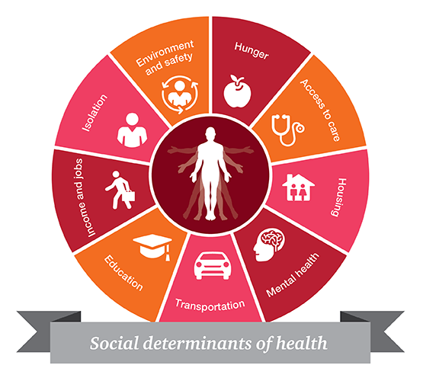
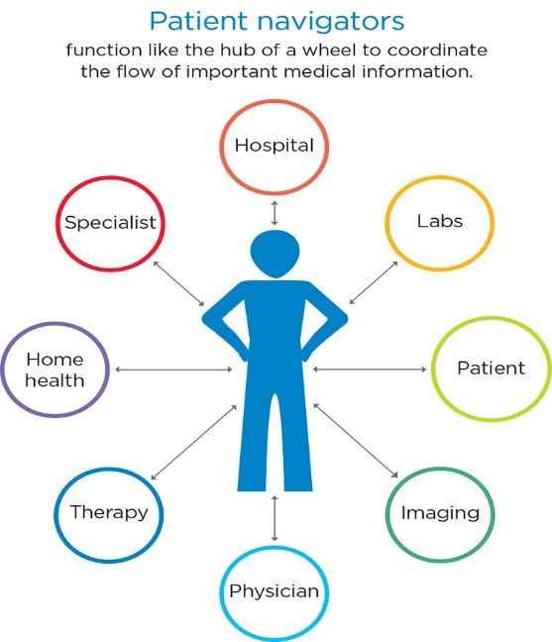
The Problem: Evidence-based strategies for combating delays in cancer care exist, but are not systematically implemented within or across hospitals
Patient Registry to Track
at risk Population Over Time
Systematic screening to address Social Barriers to Care
Patient Navigation to Guide and Support

Slide 3
City-Wide Collaboration
Research Leads from 4 Clinical Translational Science Institutes
Community Partners
6 Clinical Sites
Funder
Collaborative Innovation Award Breast Cancer Disparities (U01TR002070)
Notes:
Table 3
Remove new patients

Slide 4
The Research Question
“Can we systematically implement evidence-based coordination of care across the city of Boston to reduce delays in care for women?”
“Can we systematically implement evidence-based coordination of care across the city of Boston to reduce delays for the most vulnerable women?”
Patient navigation network
(Provider/Care Teams)
Shared registry
(Health System)
Social needs assessment and referral
(Individual Patient)

Slide 5
The Research Question
“Can we systematically implement evidence-based social needs screening across the city of Boston to reduce delays in care for women?”
“Can we systematically implement evidence-based coordination of care across the city of Boston to reduce delays for the most vulnerable women?”
Social needs assessment and referral
(Individual Patient)

Slide 6
Objectives of today’s presentation
To describe fidelity to standardized implementation of social needs screening
To describe the acceptability of social needs screening by navigators and patients
To identify factors to improve social needs screening from a health care system perspective

Slide 7
Research Methods
Community-engaged implementation science: Integrating evidence-based interventions in partnership with key stakeholders
Type 1 hybrid clinical effectiveness-implementation trial:
Clinical outcomes: time to treatment; quality of care
Implementation outcomes: acceptability, adoption, fidelity to protocol and cost
Pragmatic clinical trial: Cluster stepped wedge study design allows for rolling out iteratively in real life practice settings

Slide 8
Research Methods
Community-engaged implementation science: Integrating evidence-based interventions in partnership with key stakeholders
Type 1 hybrid clinical effectiveness-implementation trial:
Clinical outcomes: time to treatment; quality of care
Implementation outcomes: acceptability, adoption, fidelity to protocol and cost
Pragmatic clinical trial: Cluster stepped wedge study design allows for rolling out iteratively in real life practice settings

Slide 9
mIXED Methods ANALYSIS
Quantitative analysis of fidelity
= Completion of social needs screening within 3 months of navigator intake
documented in health record or 3rd party platform
Multivariable analysis factors associated with screening
Qualitative analysis of acceptability, barriers to screening
Stakeholder semi-structured interviews with patients and navigators
Rapid qualitative analysis

Slide 10
Results
589 women with new breast cancer diagnosis
across 6 health care systems in Boston
Represents all academic health centers
49% spoke primary language other than English
48% had Medicaid (coverage for low income patients)
Notes:
Race/Ethnicity
Non-Hispanic White
47.2%
Non-Hispanic Black
75.6%
Non-Hispanic Asian
74.7%
Hispanic
67.1%
Insurance
Private/Commercial
71.2%
Medicare
75.3%
Medicaid or Uninsured
66.2%

Slide 11
Fidelity to Screening for Social Needs
Race/ethnicity Insurance
Notes:
Latina<0.01 white and black
Medicare private
% not working, data correct in the excel data (unable to change data –NDA)
Race/Ethnicity
Non-Hispanic White
47.2%
Non-Hispanic Black
75.6%
Non-Hispanic Asian
74.7%
Hispanic
67.1%
Insurance
Private/Commercial
71.2%
Medicare
75.3%
Medicaid or Uninsured
66.2%

Slide 12
Acceptability to Social Needs Screening by Navigators
“I will continue to be asking these really relevant questions to my patients, to find out what their needs are, and how we can help them to get better access to care”.
“We likely identified more patients who needed social needs support, that that made their care experience all that much richer”.
Notes:
Create slide with icons and thought bubbles

Slide 13
Acceptability to Social Needs Screening by Patients
“I'm so glad they asked me about this question, because sometimes you we don't want to share things like that… Sometimes it can be stressful or you'd be ashamed, but I really was happy they asked me...”
“I felt really taken care of.”
“They definitely made me feel very comfortable with speaking with them, with especially with my needs, so that I can feel more at ease.”

Slide 14
Factors to improve social needs screening : Integration of navigators into care team
“ensuring that the entire team knew that patient navigation was already engaged with these patients prior to appointments”
“[members of the cancer care team] let you know if they have a new referral or they think someone could use services. Being present is very important."

Slide 15
Factors to improve social needs screening : More time for navigator and patient to develop trust
“At first, they were not very successful again, because the nurse navigators didn't always really have time to do the social needs assessments or the wherewithal to do them.”

Slide 16
Factors to improve social needs screening : Communication skill training to address stigma and emotions
“[It is] difficult at times to know whether patients were being honest with us as far as the social needs”
“Once you have more experience and then you know how to provide the patient directly the support…”

Slide 17
Conclusion
Social needs screening can be implemented for patients with new cancer diagnosis:
With modest fidelity
Acceptable to patients
Acceptable to navigators
Requires:
Integration of navigators into care team
Time for navigator and patient to develop trust
Communication skills training for navigators to address stigma and emotions

Slide 18
Acknowledgements
Data Analysis
Biostatistics and Epidemiology Data Analytics Center (BEDAC)
Christine Lloyd-Travaglini MPH
Clara Chen MPH
Research Leads
Tracy Battaglia MD MPH
Karen Freund MD MPH
Stephenie Lemon PhD
Jennifer Haas MD MPH
Amy LeClair PhD
Cheryl Clark MD ScD
Erika Christenson MPH
Deborah Amburgey BS
Funders
NIH --National Center for Advancing Translational Services
American Cancer Society
Stakeholders
Boston Patient Navigator Network
Boston Breast Cancer Equity Coalition
Clinical Advisory Panel
Steering Committee
Academic Medical Centers
Boston Medical Center
Beth Israel Deaconess Medical Center
Tufts Medical Center
Massachusetts General Hospital
Dana-Farber Cancer Institute
Brigham and Women’s Faulkner Hospital
Harvard Medical School

Slide 19
Back up slides

Slide 20
Eligibility Criteria
All:
Age ≥ 18 years
Sex: Female
Diagnosis: Breast cancer
Lives within 25 mi of Boston
At least one:
Black and/or Hispanic/Latina
Preferred language is not English
Uninsured or on public insurance
AND

Slide 21
Type 1 Hybrid Effectiveness-Implementation Trial Cluster Randomized Stepped Wedge Study Design
Site | Pre-TRIP | Y1 | Y2 |  |  |  | Y3 |  | Y4 | Y5
1 |  |  | Brigham and Women’s Faulkner Hospital
2 |  |  |  | Beth Israel Deaconess Medical Center
3 |  |  |  |  | Tufts Medical Center
4 |  |  |  |  |  | Boston Medical Center
5 |  |  |  |  |  |  | Mass. General Hospital
6 |  |  |  |  |  |  |  | Dana-Farber Cancer Institute
ID by Line Icons Pro from NounProject.com
Dream by Adrien Coquet from NounProject.com

