Slide 1
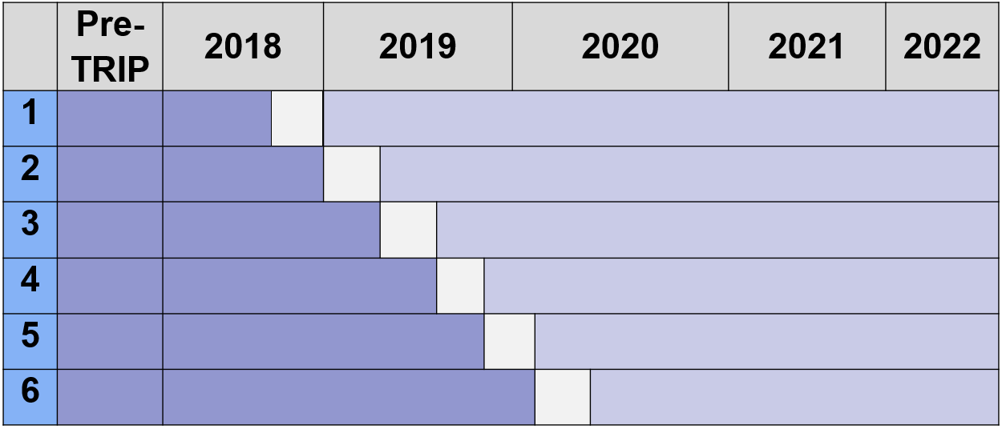
Translating research into practice: Community- engaged Implementation of city-wide breast cancer patient navigation to reduce disparities
TA Battaglia, KM Freund, JS Haas, SC Lemon, on behalf of the TRIP Consortium
BACKGROUND
RESULTS
IMPLEMENTATION RESULTS
Delays in breast cancer care contribute to poor outcomes among women of color and uninsured
Patient navigation reduces delays, yet barriers to implementation exist
Community-engaged approaches are necessary
The Boston Breast Cancer Equity Coalition collaborated with 4 Clinical Translational Science Institutes in Massachusetts to design, conduct and evaluate a City-wide navigation program
Table 1 Socio-demographics of TRIP participants (n=1725)
Figure 1. Fidelity to TRIP protocol among intervention group (n=1175)
Navigators reported:
Intervention protocols acceptable and helped formalize navigation process within hospital
variability in how they identified eligible patients
disruption during the COVID pandemic
Patients reported feeling supported when asked about social needs
Characteristic | Control (n=550) | Intervention (n=1175)
<50 50-64 65+ | 24% | 25%
 | 39% | 41%
 | 37% | 34%
Hispanic NH Black NH Asian | 23% | 25%
 | 44% | 41%
 | 13% | 11%
Medicaid Medicare | 44% | 49%
 | 18% | 18%
Non-English | 50% | 42%
Table 4. TRIP Intervention adoption
Barriers | Facilitators
Tension for change Lack of integration into care teams Telephone v. in-person Language barriers Incompatible data systems Documentation burden | Alignment of protocol with hospital focus on social needs Standard protocol adapted to existing workflow Established relationships Empathic inquiry training
METHODS
Translating Research Into Practice (TRIP) is a Type 1 hybrid effectiveness-implementation trial
Cluster-randomized, stepped wedge design
Figure 2. Intervention Group: Percent initiated treatment by navigation status at 30, 60 and 90 days (n=1175)
TRIP Intervention
Standardized navigation protocol
Shared patient registry across hospitals
Systematic screening for social needs
LIMITATIONS
Eligibility Criteria
New female breast cancer diagnosis
Resident of Greater Boston
And at least one risk factor:
Black and/or Hispanic ethnicity
Non-native English speaker
No Insurance or public insurance
Generalizability
Boston health systems with existing navigation
English speaking patients interviewed
COVID-19 pandemic caused care disruption
CONCLUSION
Despite community engaged implementation, we observed low fidelity to the patient navigation protocol
Receipt of the navigation protocol was associated with more timely care
Adoption of evidence-based patient navigation requires alignment with existing health system priorities, data systems that are feasible and integration with care teams.
Outcomes
Time to first treatment: number of days from diagnosis to initiation of any treatment
Guideline Concordant Care: adherence to National Comprehensive Cancer Network guidelines
Intervention acceptability: patient and navigator interviews to assess barriers and facilitators
Analysis
Intent to Treat Analysis included all eligible patients in the study period
As Treated Analysis compared those in the intervention period who received protocol
*Adjusted for time by chronological quarter and clustering by study site
Rapid qualitative analysis of interviews
Table 2. Intent to Treat Analysis: intervention group compared with control group (N=1725)
Table 3. Intervention Group Only: compared with those who received no navigation (n=1175)
 | aHazard Ratio* | 95% Confidence Intervals
Intervention | 0.893 | 0.719 | 1.110
 | aHazard Ratio* | 95% Confidence Intervals
Navigated | 0.950 | 0.711 | 1.270
Navigated w/Social Screen | 1.241 | 1.074 | 1.435
Table 3. Guideline Concordant Care: percent adherent to each guideline by navigation status
Guideline | Not Navigated | Navigated | Navigated w/Social Screen
Radiation (n=633 ) Hormone (n=426 ) Chemotherapy (n=109 ) | 84% | 88% | 87%
 | 84% | 93% | 90%
 | 90% | 94% | 98%
Award: U01 TR002070-01
Clinical Trial: NCT03514433

