Slide 1



Translating Research Into Practice:
Patient Navigation in Oncology Care
Tracy A Battaglia MD MPH
Clinical/Research Medical Grand Rounds
May 19, 2023
Notes:
Add in TRIP overview

Slide 2


“Personal” Disclosure
1990: Stage IV Hodgkins Lymphoma
White, professional: place of privilege
Did not share the same care experience as my patients
Career focus - understanding and addressing care differences for women historically marginalized
2018: Stage I ER-/PR-/Her2+ Breast Cancer
We have a long way to go to get to equity………

Slide 3
Objectives
Provide a framework for addressing pervasive cancer inequities through patient navigation
Describe the story of how stakeholders have come together to advance the science of patient navigation – as one of the only proven interventions to address cancer inequities
Discuss a sustainability framework to ensure the future of patient navigation in oncology care

Slide 4
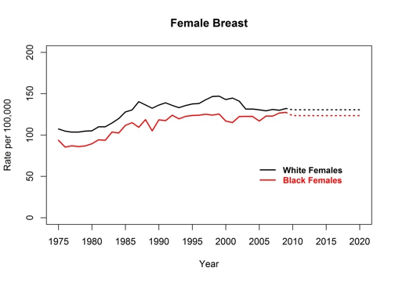
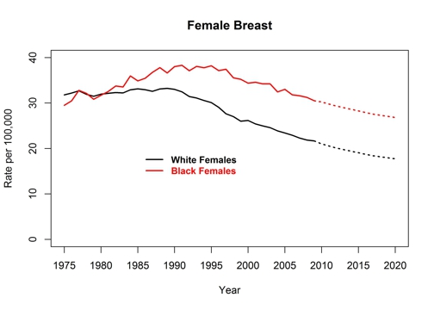
Breast Cancer Incidence and Death Rates
United States, 1975-2020
Division of Cancer Prevention and Control Centers for Disease Control and Prevention (2018).

Slide 5

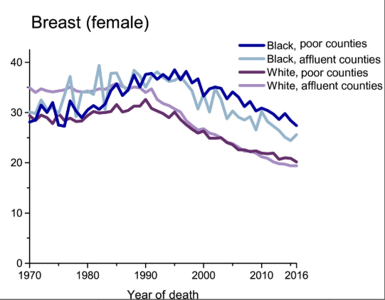
Cancer Mortality Rates by County-Level Poverty, United States, 1970-2016
Cancer Mortality Rates by County‐Level Poverty, United States, 1970 to 2016. Rates are per 100,000 population and are age adjusted to the 2000 US standard population. County‐level poverty was derived from the 2012 to 2016 American Community Survey. “Poor” and “affluent” refer to extreme county‐level poverty categories: 21.18% to 53.95% and 1.81% to 10.84%, respectively.
Siegel, R.L., et al. (2019). CA: A Cancer Journal for Clinicians.

Slide 6
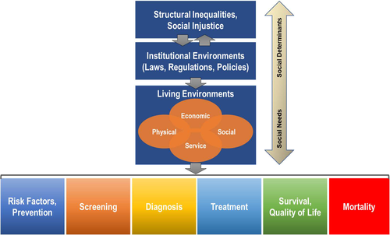
Social Determinants and Cancer Disparities
CA A Cancer J Clinicians, Volume: 72, Issue: 2, Pages: 112-143 December 2021
Notes:
These disparities have largely been attributed to differences in exposure to risk factors, early detection, and access to preventive care and treatment,⁹⁻¹¹ which themselves are influenced by social determinants of health. Racism and discrimination are a deeply rooted social determinant of health that have downstream effects resulting in social inequities and discriminatory policies, which are significant root causes of health disparities

Slide 7

The Problem: Care Delivery Disparities*
Discovery
Development
Delivery
Critical disconnect between cancer discoveries and care delivery to all patients*
*2013 IOM Report: The Cancer Care Delivery System is in Crisis
Notes:
7
Threatens the realization for health equity

Slide 8
Compared to White women, Black women are:
Less likely to:
More likely to:
have BRCA testing
receive mammogram screening
receive breast conserving surgery
receive breast reconstruction
have oncotype DX testing
complete chemotherapy
adhere to oral medications
experience social barriers to care
detect cancer by self exam
have delays in diagnosis
have advanced stage at diagnosis
have dose delays in chemo
miss treatment appointments
Have premature mortality

Slide 9



  Women’s Health Unit
  A DHHS Center of Excellence in Women’s Health
Primary-care based academic clinical research unit
Vision: Lead the nation in delivery of equitable,
comprehensive, coordinated and compassionate
women’s health care
Research
(Care delivery)
Training
&
Education
Clinic care
coordination
Community Engagement

Slide 10
Breast Cancer Care at BMC
EMR Chart review
Diagnosis: In 2005, 36% referrals for screening abnormality NEVER arrived for evaluation (Battaglia et al, Cancer 2007)
Treatment: ER+/PR+ Breast Cancer 2006-8
36% non-complaint initiation HT within 1 year
Non-complaint: non-white, non-US born
Longest delays related to social barriers, language, transportation, insurance, health literacy (Crowley, Battaglia et al, J Onc Practice, 2014)

Slide 11
Days to Diagnosis After Abnormal Mammogram
*Battaglia et al Cancer 2010.
Notes:
Among 523 women with mammography abnormalities and 474 women with Pap test
abnormalities, >90% achieved diagnostic resolution within 12 months. Median time to resolution
was longer for Pap test than for mammography abnormalities (85 versus 27 days). Site of care, rather
than any sociodemographic characteristic of individuals, including race/ethnicity, was the only
significant predictor of timely follow up for both mammogram and Pap test abnormalities.

Slide 12
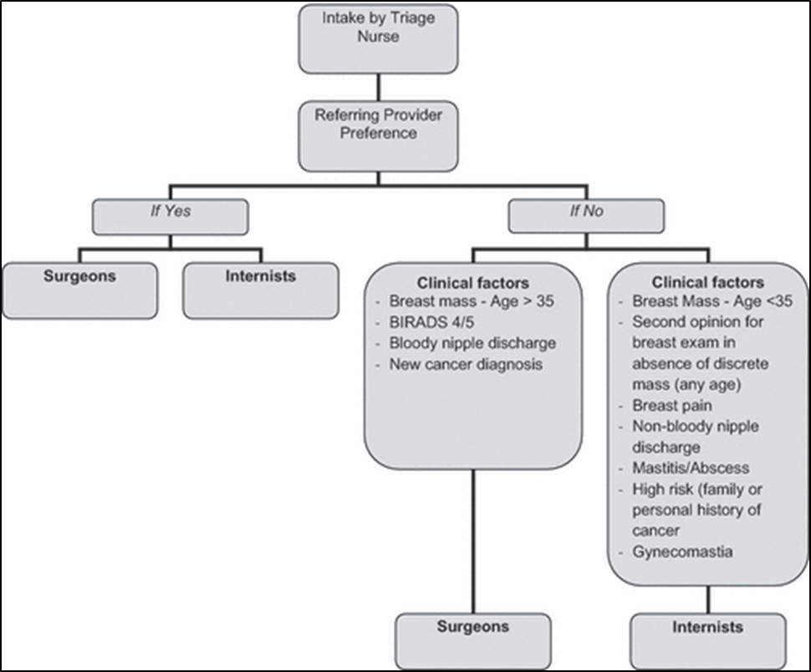
The Addition of Internists to Breast Practice
Multi-disciplinary practice
  Primary care
  Surgical oncology
  Breast Imaging
  Cyto-pathology
Timely care supported by:
  Triage system
  Patient Navigators
Battaglia, T.A., Howard, M.B., Kavanah, M., Prout, M.N., Chapman, C., David, M.M., McKinney, R., Kronman, A., Dumont, T., Freund, K.M. (2011). The Breast Journal.

Slide 13

Patient Navigation pilot study
A culturally congruent lay health worker guided by principles of Care Management:
    Identify patient in need of support
    Identify individual barriers to care
    Design and implement care plan
    Long term tracking
Goal = reduce delays in getting timely diagnosis after an abnormal breast screening

Slide 14
Timely Follow-Up (N=1,391) arrival to diagnostic appointment within 120 days
Pre-Intervention | 64%
Intervention | 79%
p <0.0001
Women in Intervention group had 39% greater odds of having timely follow-up
Battaglia, Roloff, Posner, Freund. Cancer 2007.

Slide 15
Phillips et al. JGIM. (2010)

Slide 16
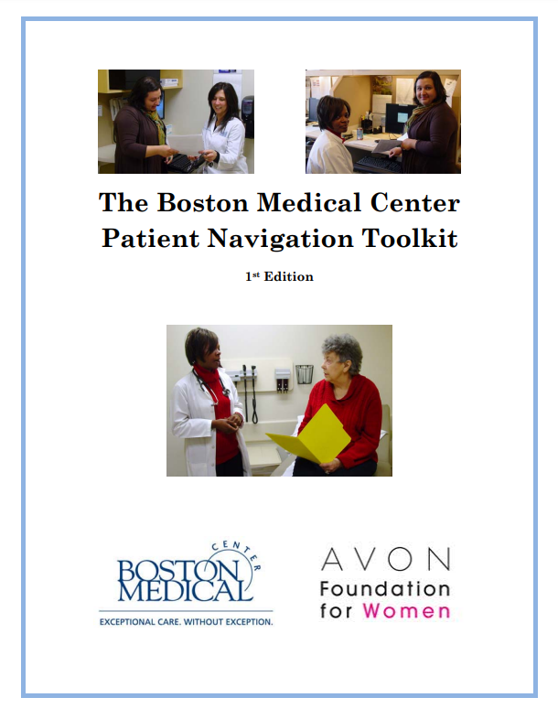
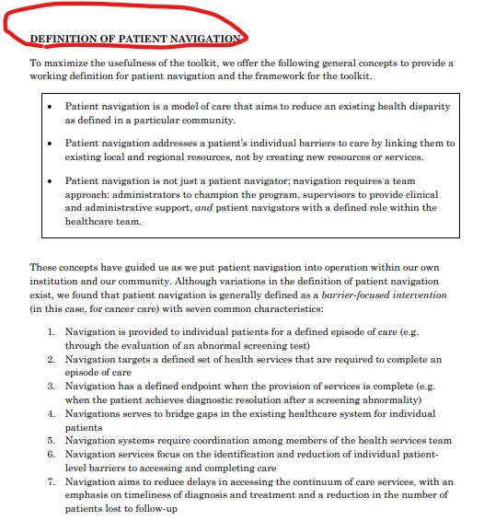

Slide 17
Oncology Patient Navigation at BMC
1999: Breast Cancer Patient Navigation Program began (MA BCCEDP & Avon Foundation)
2005: Selected as site for the NCI Patient Navigation Research Program
2012: PCORI and ACS funding to study innovations in navigation
2017: NCATs funding to study city-wide breast navigation program: TRIP
2022: Merck Oncology Equity Alliance and ACS PN Capacity-Building Iniiative
Patient Navigation Process*
  Identify those in need of navigation (e.g. patients most at risk for delays in care)
  Identify individual barriers to treatment
  Link patient to available resources to address and overcome those barriers
  Track patients over time to their treatment appointments
*joint position statement of the Oncology Nursing Society, the Association of Oncology Social Work
Notes:
Link: https://journals.lww.com/oncology-times/Fulltext/2010/05250/ONS,_AOSW,_and_NASW_Release_Position_Statement_on.18.aspx
ONS, AOSW, and NASW Release Position Statement on Patient Navigation, Oncology Times: May 25, 2010 - Volume 32 - Issue 10 - p 62 doi: 10.1097/01.COT.0000381224.45804.c5

Slide 18
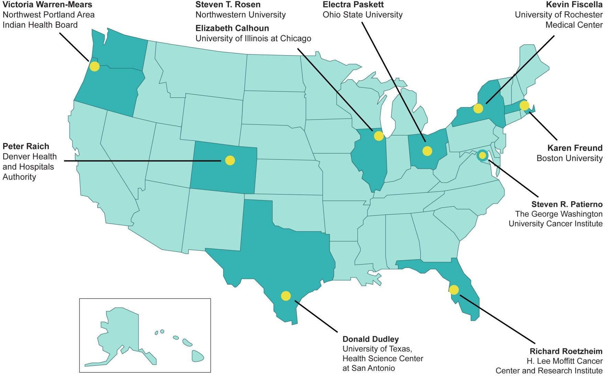

Patient Navigation Research Program (PNRP)
Notes:
18

Slide 19

U.S. Healthcare System
Employment/
Loss Wages
Language/interpreter
Fear
Location of Facility
Problems with Scheduling
Transportation
Perceptions and Beliefs
Comorbidities
Communication with Medical Personnel
Uninsured,
Underinsured
Disability
Healthcare Barriers
Literacy
Child/Adult Care
Notes:
19

Slide 20
PNRP Main Questions
Will navigated patients…
Receive timelier, definitive resolution following an abnormal finding?
Receive timelier treatments following a positive diagnosis?
Improve their satisfaction with the health care system experience?
Notes:
20

Slide 21
Boston Patient Navigation Research Program
Dorchester
S. Boston
Whittier
Codman
E. Boston
Roslindale
= Breast Cancer Patient Navigator, Cervical Cancer Comparison Site
= Cervical Cancer Patient Navigator, Breast Cancer Comparison Site

Slide 22
Patient Navigation
Case identification
Abnormal screening
List of 21 pre-defined barriers
Identify Barriers
List of 10 actions
Develop/Implement plan to address barriers
Multiple
Encounters
Tracking
Tracking
Resolution
Azadeh Nasseh, 2011

Slide 23
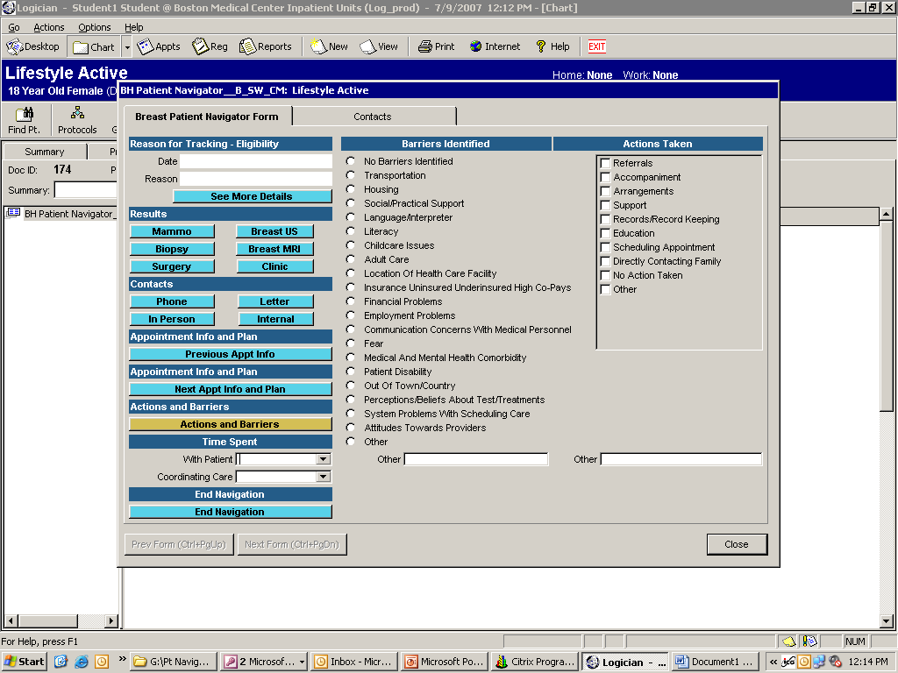
Navigator log in EMR (Logician)

Slide 24
National PNRP Methods
Breast, Cervical, Colorectal or Prostate
  Screening abnormality
  New cancer diagnosis
Kaplan Meier survival curve estimate time to care
Adjusted Hazards Ratio (aHR) > 1.0 more timely care
Meta-analysis
Notes:
In order to address both the time to diagnostic resolution and the censoring for lack of ever reaching resolution we developed Kaplan-Meier survival curves and proportional hazards regression models to examine the effect of patient navigation on time to definitive diagnosis. The Kaplan Meier curves and hazards ratios were calculated separately for breast and cervical cancer screening abnormalities. The adjusted Hazards Ratios for the proportional hazards models. where the hazard ratio greater than 1.0 indicates that patient navigation is associated with a greater likelihood of diagnostic resolution.

Slide 25
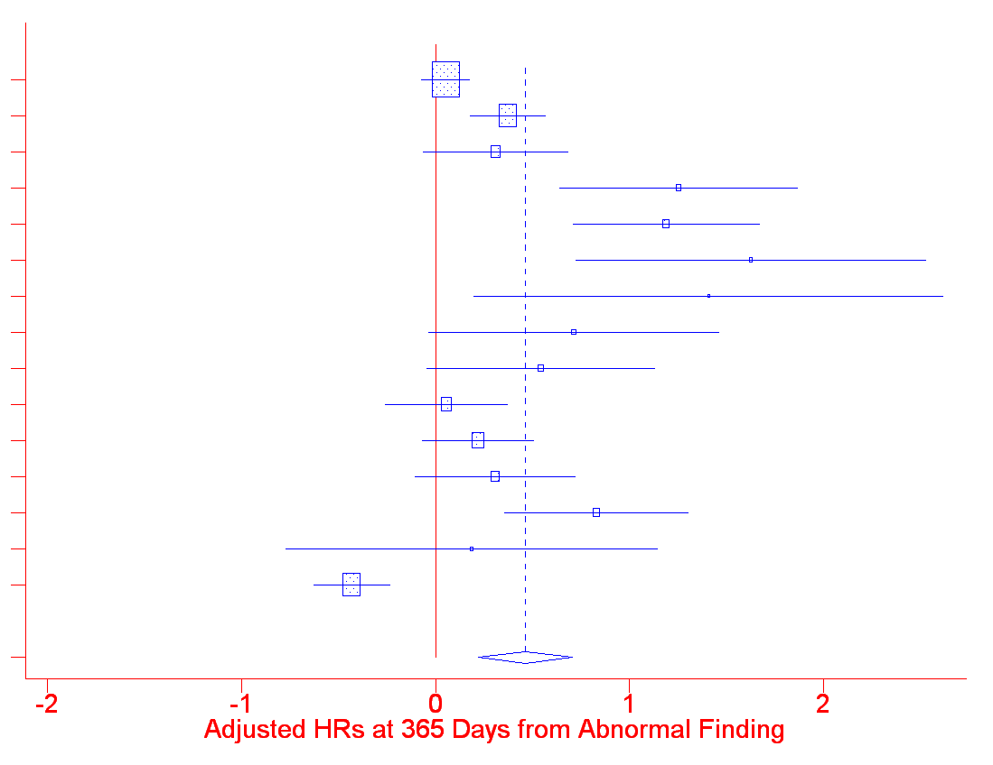
Meta-Analysis: Diagnostic Resolution at 365 Days
A breast
A cervix
B prostate
B breast
B cervix
C breast
C colorectal
C prostate
D breast
D cervix
E breast
E cervix
F breast
F colorectal
G breast
ALL
0.3
0.5
1
2
3
aHR = 1.4 (95% CI 1.2 – 1.7)

Slide 26
Adjusted Odds Ratios for Treatment Measures
Adjusted for age, race, insurance, marital status and study design
Quality Measures | aOR | 95 % CI | P value
Hormone Therapy | 1.78 | (1.22, 2.57) | 0.002
Radiation Therapy post Lumpectomy | 1.12 | (0.70, 1.79) | 0.643
Chemotherapy | 0.48 | (0.24, 0.95) | 0.035
Ko NY, Darnell JS, Calhoun E, Freund KM, Wells KJ, Shapiro CL, Dudley DJ,Patierno SR, Fiscella K, Raich P, Battaglia TA. Journal of Clinical Oncology. (2016)

Slide 27

Joint Position on Role of Oncology
Nursing and Social Work in Patient Navigation
“individualized assistance offered to patients, families, and caregivers to help overcome healthcare system barriers and facilitate timely access to quality health and psychosocial care from pre-diagnosis through all phases of the cancer experience”
Outcomes are optimal when:
  social worker, nurse, and lay navigator (defined as a trained nonprofessional or volunteer) function as a multidisciplinary team
  address ‘underserved’ communities
  scope of work and competencies of navigators are clearly defined

Slide 28

2012

Slide 29
Navigator Activities Matter
Task/Network | Patient | Provider | Staff | Support | EMR
Navigate with specific pt | YES
Facilitate for specific pt |  | YES | YES | YES
Maintain system for all |  |  |  |  | X
Document/ Review |  |  |  |  | X
Clark JA, Parker VA, Battaglia TA, Freund KM. Health Care Manage Rev 2014
Notes:
29
Define attributes of the work of patient navigators
Describe variation in navigation
Develop an evaluation instrument for observing navigator work that produces valid, reliable data across sites
Use this instrument to define and compare across sites and programs
*leveraged funds through the Avon foundation

Slide 30
Type of Barriers Matter
Ramachandran A, Freund KM, Bak SM, Heeren TC, Chen CA, Battaglia TA. J Womens Health 2015
Notes:
Those with one barrier in the other barrier category had less timely resolution than those with no barriers (p=0.010). Those with two or more barriers including a social service barrier had a significantly longer time to resolution than those with no barrier (p<0.001), those with one other barrier (p=0.001), and those with two or more other barriers (p=0.014).

Slide 31

“Socio-legal” Barriers to Care at BMC
104 survey respondents seeking cancer care
‘Over the past two weeks I have been concerned about…’
  Income Supports
  Housing
  Education/Employment
  Legal Status
  Personal and Family Stability & Safety
80 (77%) reported 1 or more concerns
Ko, Battaglia, et al. BMC Health Services Res 2016

Slide 32
Project SUPPORT*
Hypothesis: Breast cancer patient navigation enhanced with legal advocacy to address socio-legal barriers will improve clinical and patient reported outcomes
RCT Comparative Effectiveness Trial at BMC
Outcomes: time to first treatment, satisfaction, cancer needs
*PCORI and American Cancer Society

Slide 33
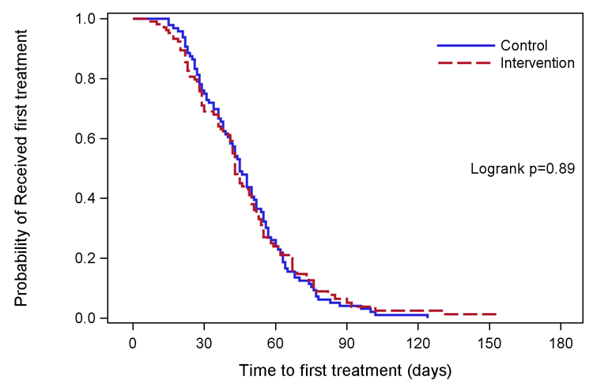
Kaplan-Meier Plot for time to first treatment (n=201)
Notes:
Kaplan-Meier estimate is one of the best options to be used to measure the fraction of subjects living for a certain amount of time after treatment. In clinical trials or community trials, the effect of an intervention is assessed by measuring the number of subjects survived or saved after that intervention over a period of time. The time starting from a defined point to the occurrence of a given event, for example death is called as survival time and the analysis of group data as survival analysis. This can be affected by subjects under study that are uncooperative and refused to be remained in the study or when some of the subjects may not experience the event or death before the end of the study, although they would have experienced or died if observation continued, or we lose touch with them midway in the study. We label these situations as censored observations. The Kaplan-Meier estimate is the simplest way of computing the survival over time in spite of all these difficulties associated with subjects or situations.

Slide 34
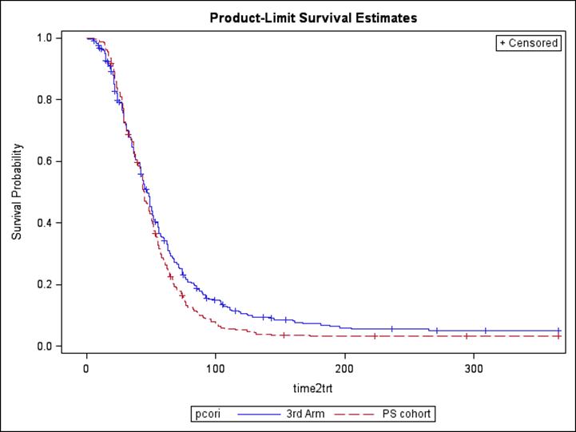
Project SUPPORT vs. Non-Navigated (3rd Arm)
aHR
2.79 (1.52, 5.13)

Slide 35
2014: Disparities Breast Cancer Mortality Increasing*
50 largest US cities 1990 - 2009
35 cities increase in Black:White mortality rate ratio
Boston had the 5th highest increase: 1.49 (95% CI 1.18, 1.88)
Increase largely because White rates improved substantially
1,710 excess Black deaths annually
an average of about 5 each day.
*Hunt, Whitman, and Hurlbert (2014). Increasing Black:White disparities in breast cancer mortality
in the 50 largest cities in the United States. Cancer Epidemiology.
Notes:
Numerator data from national death files
Population-based denominators from the U.S. Census Bureau
*Where Black = non-Hispanic Black and White = non-Hispanic White

Slide 36
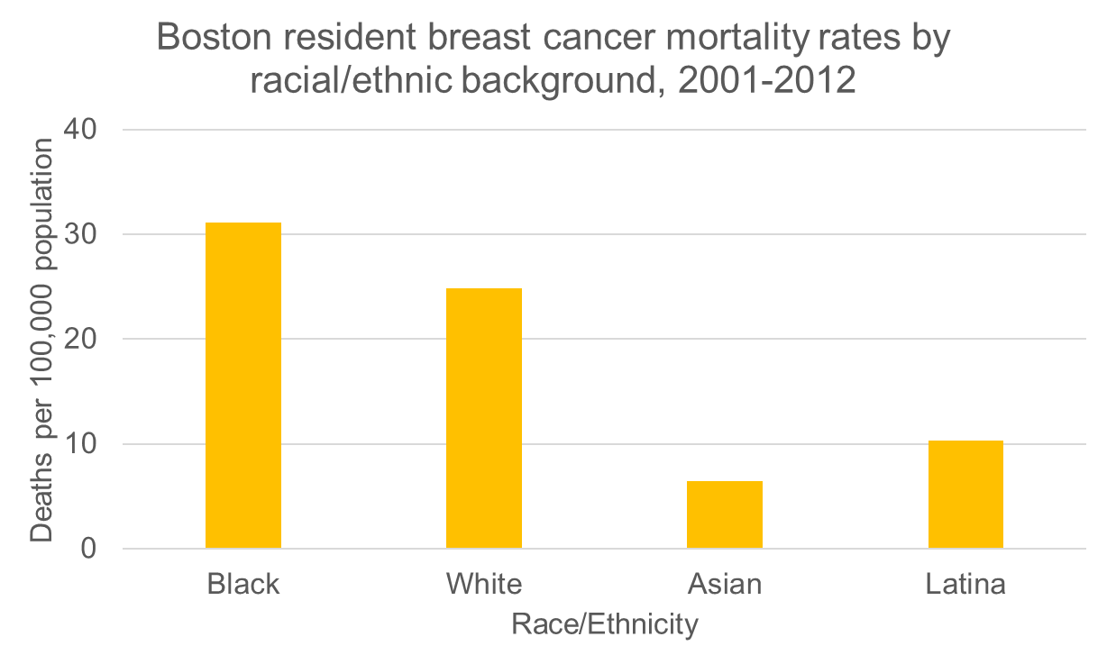

The Boston Breast Cancer Equity Coalition
How can a city replete with many so many resources continue to tolerate such disparities??
Mission: Develop city-wide solutions to eliminate inequities in breast cancer outcomes
www.bostonbcec.org
Notes:
Jennifer

Slide 37
Treatment Delays among Black NH and Medicaid
Black NH and Medicaid patients are 2-3x more likely to have delays in initiating treatment > 60 days
Source: MA Cancer Registry
Notes:
Jennifer
Data not published: MA Cancer Registry
In Boston,
Black non-Hispanic women have a mean time to first treatment of 54 days (SD 47.4) vs 41 days for White non-Hispanic women (SD 35.2)*
Karen
I removed image, as not really clear -- changed to Jennifer’s data

Slide 38
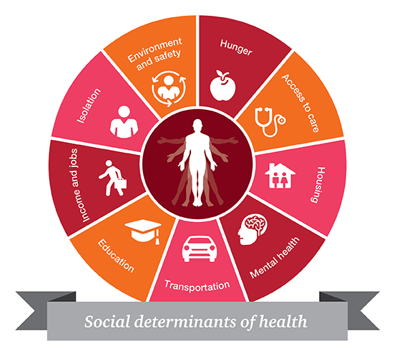
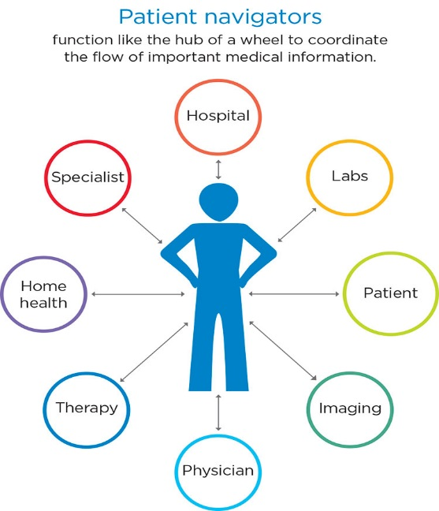
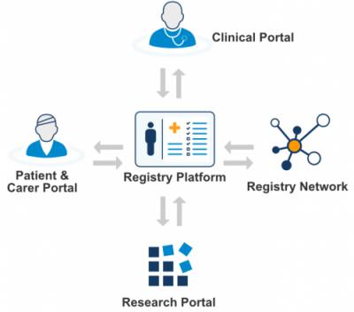
The Problem: Evidence-based strategies for combating delays do exist, but are not systematically implemented within or across hospitals
Patient Navigation to Guide and Support
Patient Registry to Track
at risk Population Over Time
Systematic screening to address Social Barriers to Care

Slide 39












City-Wide Collaboration
Research Leads
Local Academic Medical Centers
Notes:
Table 3
Remove new patients

Slide 40
The Research Question
“Can we systematically implement evidence-based navigation across the city of Boston to reduce delays in care for women?”

Slide 41
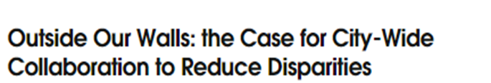
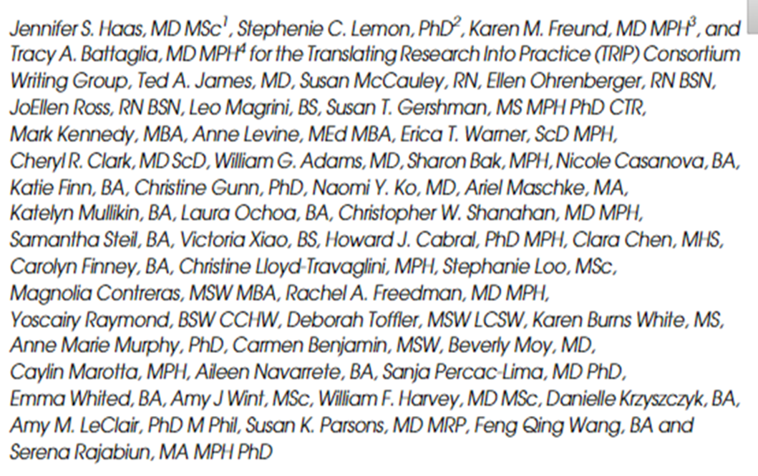
“Elimination of health disparities requires a paradigm shift from individual or institutional responsibility to regional responsibility; this revised focus is critical to address delivery gaps that promote disparities, and presses institutions to work collaboratively to take responsibility for events that occur outside of their walls.”
Journal of General Internal Medicine, volume 36
Notes:
Tracy, pass to Jennifer

Slide 42
Research Methods
Community-engaged implementation science: Integrating evidence-based interventions in partnership with key stakeholders
Type 1 hybrid clinical effectiveness-implementation trial:
  Clinical outcomes: time to initiation of treatment; quality of care
  Implementation outcomes: acceptability, adoption, fidelity to protocol, sustainability, and cost
Pragmatic clinical trial: Cluster stepped wedge study design allows for rolling out iteratively in real life practice settings

Slide 43
Stakeholder groups
Tracy Battaglia MD MPH (BU/BMC)
Karen Freund MD MPH (Tufts)
Jennifer Haas MD MPH (MGH)
Stephenie Lemon PhD (UMass)
Principal Investigators
Erika Christenson (Project Manager)
Debi Amburgey (Project Coordinator)
BMC Research Team
Mady FitzGerald (RA)
Julia Vance (Project Coordinator)
Tufts
Registry
Karen Freund MD, MPH
Amy LeClair PhD
Will Harvey MD
BEDAC
Clara Chen
Carolyn Finney
Chris Lloyd-Travaglini
BMC
Bill Adams MD
Chris Shanahan MD
Cost
Howard Cabral PhD (BU)
Serena Rajabiun PhD (UMass Lowell)
Implementation
Stephenie Lemon
Amy LeClair
Aunt Bertha/SDoH
Jennifer Haas, MD MPH
Caylin Marotta MPH (MGH)
Cheryl Clark MD, ScD (BWH)
Amy Wint, MPH (MGH)
Steering Committee
Karen Burns White (DFCI)
Rachel Freedman MD (DFCI)
Howard Cabral PhD (BU)
Tracy Battaglia
Christine Gunn
Stephanie Loo
Ariel Maschke
Sharon Bak
Courtney Winkle-Miller
Nicole Casanova
Victoria Xiao
Katelyn Mullkin
Maha Ashraf
Steve Kanem
Charlotte Robins
Clinical Advisory Panel (CAP)
BMC
Naomi Ko MD, MPH
BIDMC
Ted James MD
Monica Valero Camacho MD
Tufts
Susan Parsons MD
DFCI
Rachel Freedman MD, MPH
MGH
Beverly Moy MD, MPH
JoEllen Ross RN
Feng Qing Wang
Joan Nagel
Anne Marie Murphy
Navigators
BMC
Jackie Hernandez (PN)
Alexis Finney (Supervisor)
BIDMC
JoEllen Ross RN (PN)
Ellen Ohrenberger RN (PN)
Tufts
Feng Qing Wang (PN)
DFCI
Magnolia Contreras (Supervisor)
Marlene Escobar (PN)
MGH
Talissa Adrien (PN)
Janice DeBrito (PN)
Supervisor
Alexis Higgins
Sam Steil
Notes:
Tracy: we intentionally engaged with diverse stakeholder groups longitudinally to guide our approach
Karen: “There are too many names to do a shout out to all, the green group reflects our research group and investigators, and within this, focused on multiple activities
We had a Steering Committee in Blue who did….
We had a group of navigators ( change to a different color) actively involved in helping the research team undersatdn how to improve the process for navigators and patients
We had a Clinical Adivsory Panel in purple who provided…

Slide 44
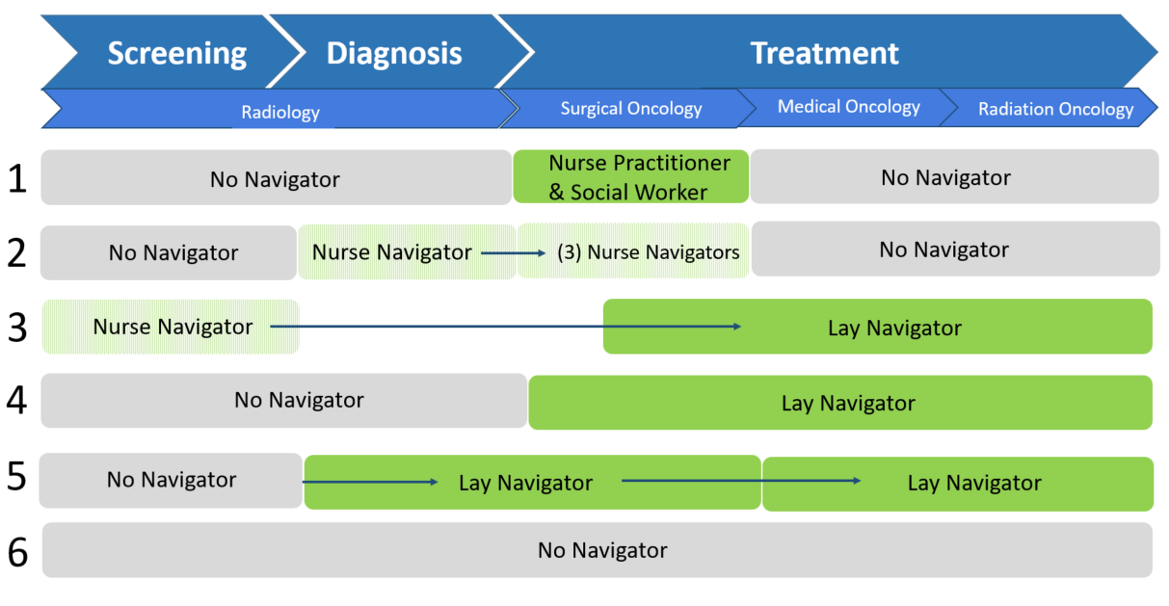
Pre-TRIP Workflows Across 6 Sites
Casanova N, et al, Cancer, 2022 vol 128
Notes:
Jennifer
At baseline: fragmented navigation with lots of gap our TRIP protocol was designed to address; Arrows signify a hand off

Slide 45
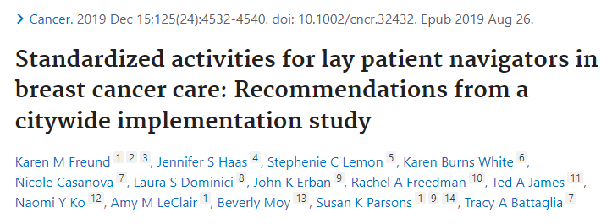
New Standard of Care Approach

Slide 46




Development of a shared Registry:
Benefits
HIPAA compliant
Free for researchers - embedded within CTSA hubs
Facilitates dissemination
Notes:
Jennifer
After considering multiple options, we chose REDCap.
REDCap has the benefits of:
- being HIPAA compliant
Generally being free for researchers that are embedded within Clinical and Translational Science Award hubs.
And we thought using REDCap would facilitate dissemination of our intervention, which is an explicit aim of our grant – if we can get this to work and move the needle on disparities in Boston, can we help other cities or regions do the same
Karen -- I removed the challenges – to streamline presentation
Choosing this platform did have some challenges:
It is designed for data capture, NOT clinical use
Optimized for well-defined time points, rather than the more fluid visit timelines in clinical care (infinitely repeating forms/events)
Switching between patient records was a little cumbersome (training on search function in reports)
This intervention presented a change in clinical workflow. Patient navigators were using multiple systems within institutions.

Slide 47
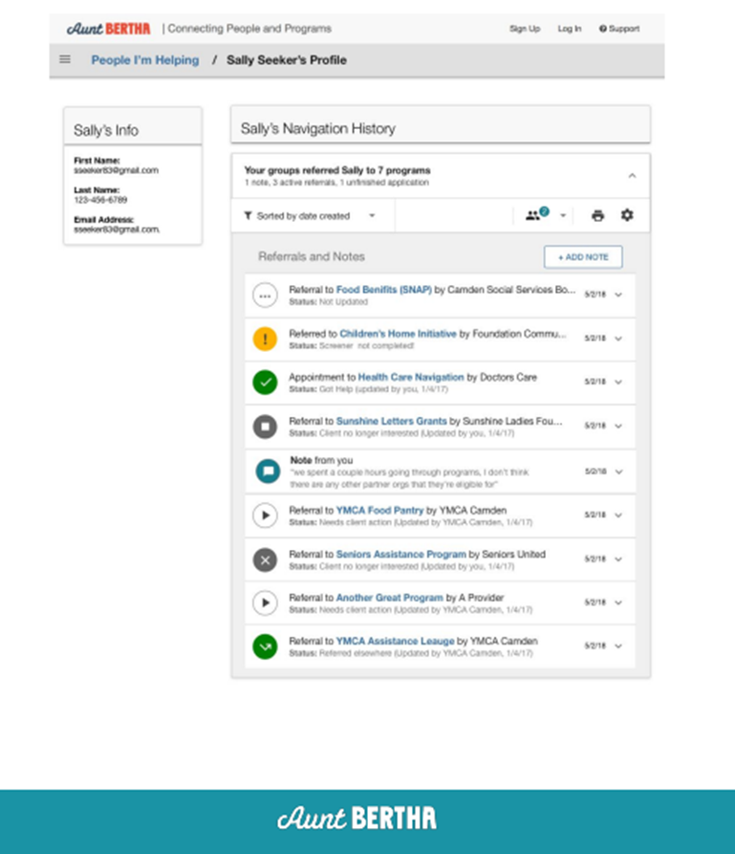
Development of a social needs survey and referral platform
Notes:
Jennifer

Slide 48
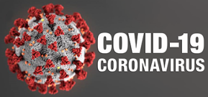
Randomized Stepped Wedge Design
 | Pre-TRIP | Year 1: 2018 | Year 2: 2019 |  |  |  | Year 3: 2020 |  | Year 4: 2021 | Year 5: 2022
1 |  |  | BW-Faulkner Hospital
2 |  |  |  | Beth Israel Deaconess Medical Center
3 |  |  |  |  | Tufts Medical Center
4 |  |  |  |  |  | Boston Medical Center
5 |  |  |  |  |  |  | Mass. General Hospital
6 |  |  |  |  |  |  |  | Dana-Farber Cancer Institute
Notes:
Jennifer: here we are today,
The big additional challenge of the grant was the pandemic

Slide 49

Eligibility Criteria
All:
Age ≥ 18 years
Sex: Female
Diagnosis: Breast cancer
Lives within 25 mi of Boston
At least one:
Black and/or Hispanic/Latina
Preferred language is not English
Uninsured or on public insurance
AND

Slide 50

Implementation Strategies
Multidisciplinary leadership through the Clinical Advisory Panel and the Scientific Steering Committee
Community Engagement: BBCEC quarterly meetings, Annual Stakeholder meeting
Protocol adaptation to existing workflow in each health system
Training and education through the Boston Navigation Network and TRIP Navigator meetings
Monitoring and feedback to each study site
Communication: Monthly Newsletter
Powell et al. Implementation Science 2015

Slide 51
TRIP Study Participants N=1732 |  | Historical Control n=553 | Intervention n=1179
Age | <50 | 24% | 25%
 | 50-64 | 39% | 41%
 | 65+ | 38% | 34%
Race/ethnicity | Hispanic | 23% | 25%
 | Non-Hispanic White | 17% | 19%
 | Non-Hispanic Black | 44% | 41%
 | Non-Hispanic Asian | 11% | 8%
Insurance | Private/Commercial | 17% | 25%
 | Medicare | 19% | 16%
 | Medicaid | 43% | 47%
Language | English | 50% | 58%
 | Non-English | 50% | 42%
Region | Boston Area | 70% | 54%
 | Greater Boston Area | 30% | 46%

Slide 52
Implementation Fidelity: did study sites successfully adopt the navigation protocol?
Levels of Fidelity | Definition
0 | No Navigation
1 | Navigator identified patient and entered in Shared Registry
2 | Social needs assessment completed at time of diagnosis
3 | Social needs assessment repeated within 6 months
Total of all 3 | In registry and two social needs assessments completed
Notes:
Tracy

Slide 53
Implementation Fidelity: did study sites successfully adopt the navigation protocol?
Notes:
There were another 600 patients across all the sites who were eligible , but were never navigated.
This took us by completed surprise
It was all sites.
Was this COVID?
Does this reflect, that despite our EMR and all our work, none of us have systems to help us find all patients in need of navigation?

Slide 54
Social Needs Assessments at diagnosis
N=407
Notes:
Tracy

Slide 55
Social Needs Assessments at diagnosis
N=196
Percentage (%)
Notes:
Tracy

Slide 56
Notes:
Tracy

Slide 57
Preliminary Implementation Data:
Interviews and Field Observations
Barriers | Facilitators | Value Added
Competing demands (COVID) Relative priority of TRIP Tension for change related to navigation Navigator turnover Incompatible data systems documentation burden | Alignment with hospital focus on social needs Adapting protocol to existing workflow Navigator integrated into care team Established relationships Language concordance Empathic inquiry | Evidence-based navigation process Regional approach Communication across systems Patients felt ‘cared’ for
S Loo et al. Patient navigator team perceptions on the implementation of a city-wide breast cancer navigation protocol: a qualitative study. BMC Health Services Research. 2022.

Slide 58
Summary
Co-created an evidence-based patient navigation protocol
Included a diverse group of breast cancer patients across City
Despite resources, implementing navigation challenging
Lack systems to identify patients
Social needs screening challenging but feasible
COVID impacted treatment
When we do navigate, it improves timely treatment!
Notes:
Stephenie/Tracy

Slide 59
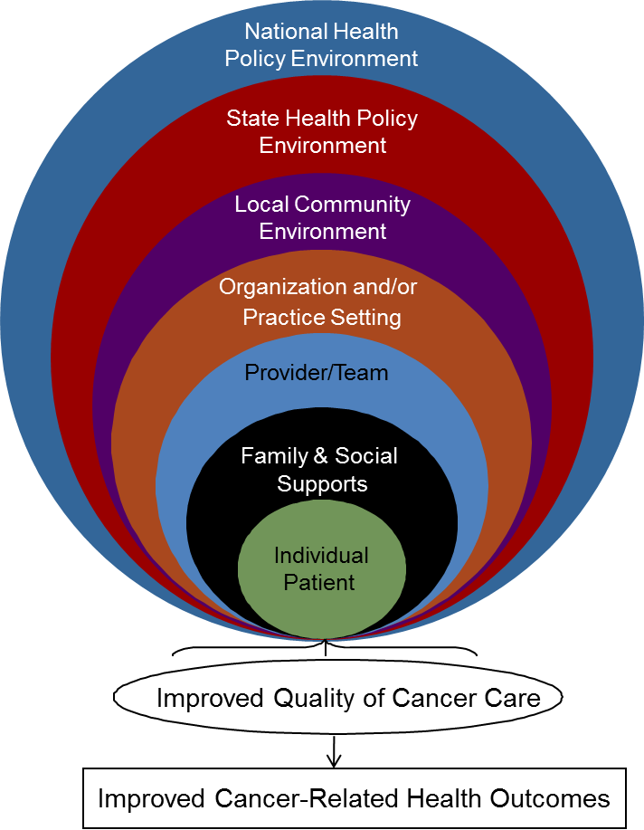
Obstacles to Patient Navigation
Patient level
  Social Needs (financial, housing, employment,
  transportation, language, cultural)
Provider/team level
  Lack of defined roles in ‘navigation’ process
  Communication between providers and navigators
Organization level
  Lack of tracking systems for at risk women
  Fragmentation of oncology services
  Resources to hire and train navigators
Community Resources
Policy to fund and support workforce

Slide 60



Alliance for Equity in Cancer Care
Proprietary
National, multi-site initiative to advance health equity by improving timely access to high-quality, culturally responsive cancer care for patients from underserved communities.
Program Partners
Boston Medical Center (Boston, MA)
Case Comprehensive Cancer Center, Case Western Reserve University (Cleveland, OH)
Conquer Cancer®, the ASCO Foundation (Dillon, MT)
Mary Bird Perkins Cancer Center (Baton Rouge, LA)
Memorial Sloan Kettering (New York, NY)
RWJBarnabas Health (New Jersey)
University of Kentucky Markey Cancer Center (Kentucky)
NPO: Virginia Commonwealth University, Massey Cancer Center (Richmond, VA)
Seven Alliance program sites
Investment: $20 Million over 5 years (2022-2027)
Our Goal
Improve coordination of cancer care for vulnerable, underserved populations
Strengthen patient-provider communication and patient engagement in treatment decisions
Build sustainable community partnerships to address barriers to cancer care
Disseminate findings and program results to improve the delivery of equitable cancer care
1

Slide 61
American Cancer Society Patient Navigation Capacity Building Grant
3-year patient navigation grant awarded to 14 health systems
HIMA San Pablo Oncologico-Caguas Caguas, Puerto Rico
University of North Carolina at Chapel Hill Chapel Hill, North Carolina
VCU Massey Cancer Center Richmond, Virginia
The University of New Mexico Comprehensive Cancer Center Albuquerque, New Mexico
University of Alabama Birmingham Birmingham, Alabama
Harris Health System Houston, Texas
Boston Medical Center Boston, MA
Montefiore Einstein Cancer Center Bronx, New York
Fred Hutchinson Cancer Center Seattle, Washington
City of Hope Los Angeles, California
The University of Chicago Chicago, Illinois
Rush University Medical Center Chicago, Illinois
Huntsman Cancer Institute at the University of Utah Salt Lake City, Utah
University of Colorado Denver Aurora, Colorado

Slide 62

Oncology Equity Alliance at BMC
BMC Patient Advisory Group
BMC Advisory Council
Tracy Battaglia, MD, MPH
Associate Chief of Research, General Internal Medicine
Associate Director, Belkin Breast Health Center
Bob David, MA
Manager, BMC Cancer Support Services
Sharon Gentry, MSN RN
Program Director, Academy of Oncology Nurses and Patient Navigators
Andrea Dwyer, MPH
Chair, National Navigation Roundtable
Mark Kennedy, MBA
Senior Program Manager, Chronic Disease Prevention & Control Division
Boston Public Health Commission
Matt Kulke, MD
Chair, Hematology Oncology
Minh Tam Truong, MBBS
Chair, Radiation Oncology
BMC Team
Navigation Leadership Team
Maddi Booth, PN Manager
Alyssa McSherry, Interim Dir. Cancer Center
Teviah Sachs, MD
Chair, Surgical Oncology
OEA Research Team
Erika Christenson
Julia Vance
Debi Amburgey
Maddi Fitzgerald
Merck Alliance
ACS Learning Collaborative

Slide 63
What has to change?
Current State | Ideal State
Pts referred to navigators post Dx | Navigation begins at Dx
No systematic Social Need screening | THRIVE screener
Navigators not integrated across care teams (silos) | Navigation process occurs across departments
Providers/care teams unaware of navigation roles | Clear role delineations (PN, nurse navigator, SW)
No cancer center policy | Create Cancer Center navigation policy
Data not real time | Real time metrics and feedback to care teams
No evidence-based practice review | Participate in national learning collaboratives
Grant and Philanthropy funding | Operational funding, workforce development

Slide 64


National Navigation Roundtable
launched in 2017
Collective action
Focus on gaps in sustainability
Evidence base, workforce, policy
Health equity lens
WHY NNRT?
Notes:
WHY NNRT
Collective action is necessary to drive the field of Navigation forward including:
Need for standardized outcome metrics
Need for a centralized plan for building the evidence base for navigation (to demonstrate effectiveness, value, and ROI)
Need for clearly defined professional roles and responsibilities (distinguish professional/clinical navigation from other occupations)
Need for workforce development path forward (professional and clinical navigators)
Need for a sustainable model for funding: policy to establish navigation as a reimbursable service
CORE Principles
Collective action among member organizations will be more successful in advancing the field than any one organization alone.
Focus on gaps: areas in the field where action is needed, but could not easily be addressed by a single organization
Do not duplicate or take on the activities of partner organizations
Health equity lens: Access to care for all is primary goal

Slide 65




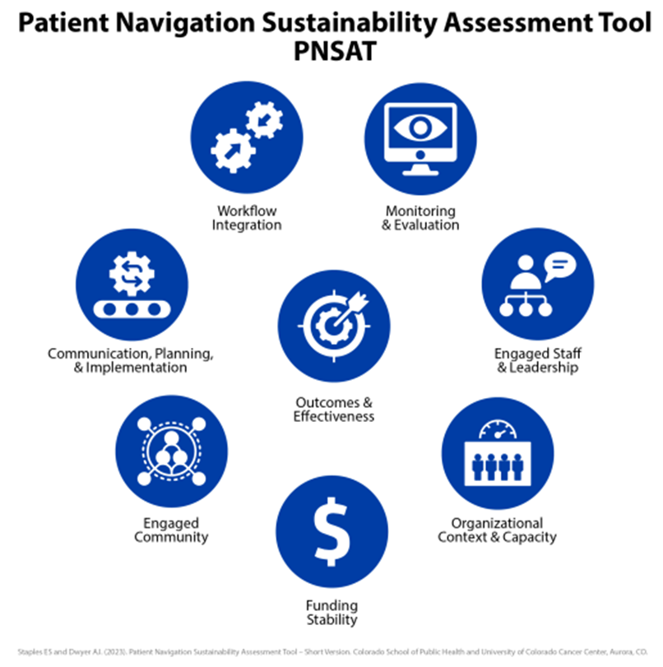
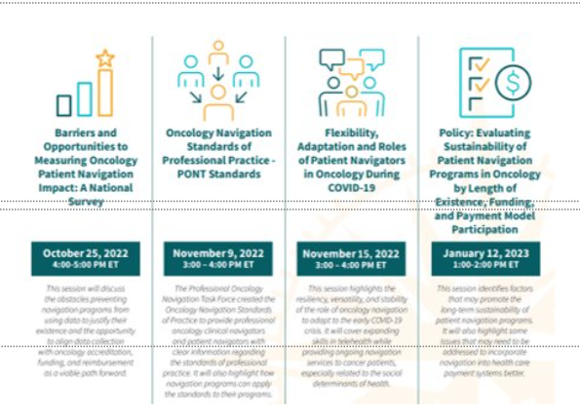

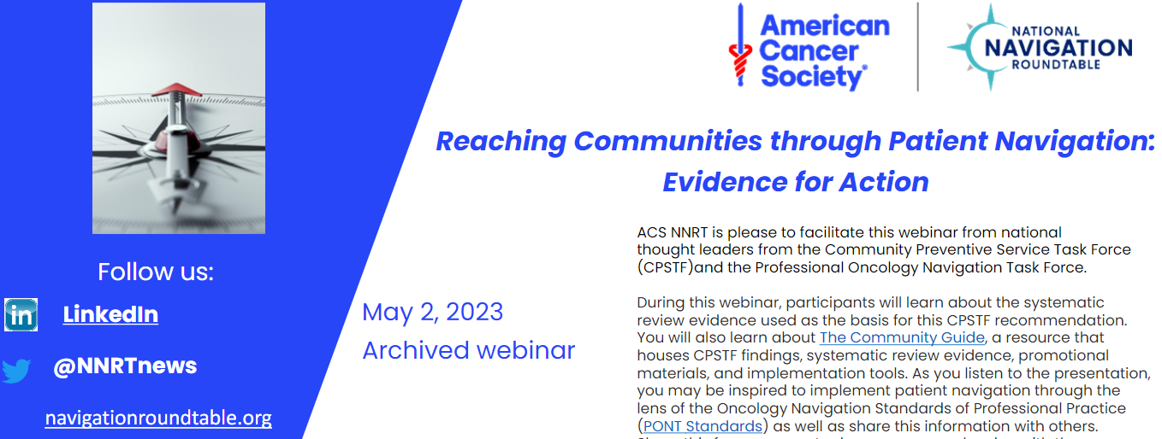
CANCER Journal June 2022
NNRT &
Partner
Impact
PONT Standards
Dissemination
Adopted by NNRT
Metrics Toolkit
AONN & NNRT
August 2020
Call to Action Series
22-23
Community Guide Webinar, May 2, 2023
Notes:
Editorial in CANCER
Workforce Development Manuscript
Head & Neck Survey

Slide 66
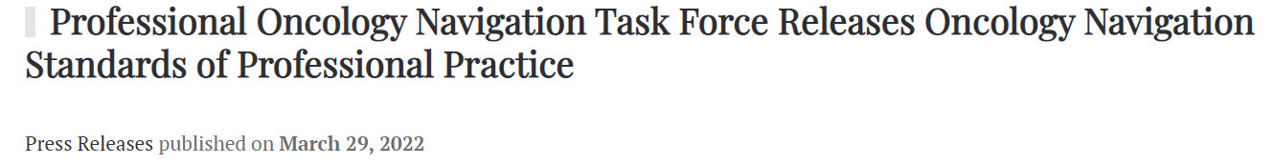
Professional Navigator: A trained individual who is employed and paid by a healthcare-, advocacy-, and/or community-based organization to fill the role of oncology navigator.
Oncology Patient Navigators
Oncology Nurse Navigators
Oncology Social Work Navigators

Slide 67
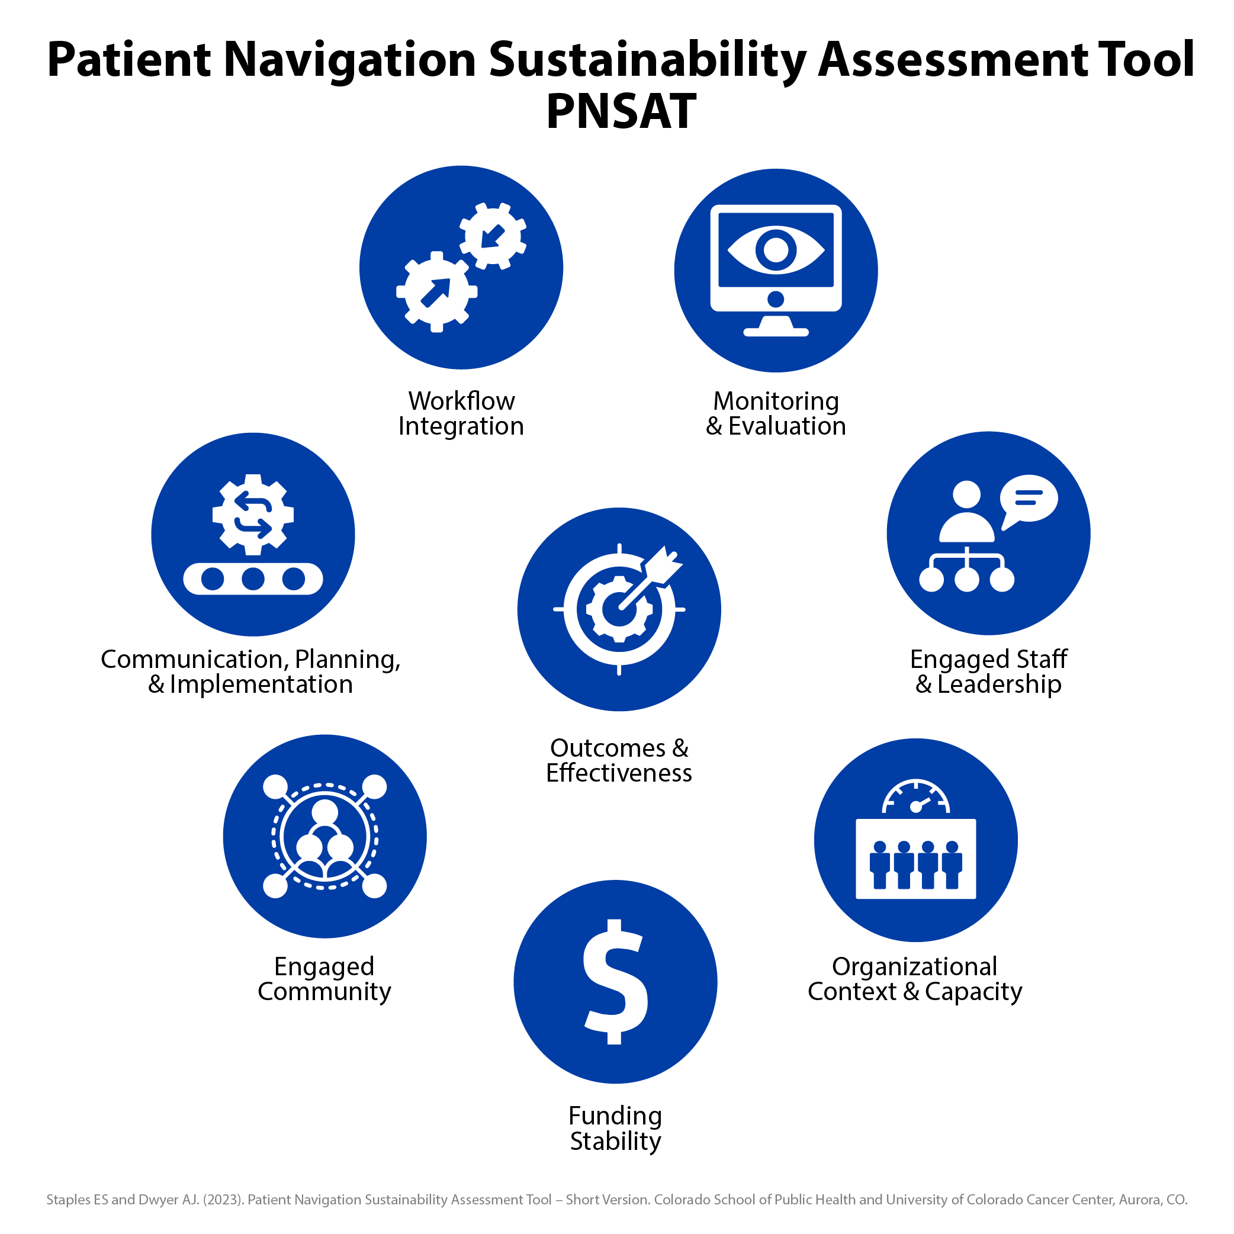



Adopted by:

Slide 68

May 10th 2023 NNRT Leadership Meeting
Special Guests
Health Resource Service Administration (HRSA)
National Cancer Institute (NCI)
Division of Cancer Prevention and Control Centers for Disease Control and Prevention (CDC)
National Comprehensive Cancer Network (NCCN)
American Society of Clinical Oncology (ACSO)
Association of Community Cancer Centers (ACCC)
American Cancer Society Extramural and Intermural Health Science Research
NNRT Steering Committee
University of Colorado
Fox Chase Cancer Center
Boston University – Boston Medical Center
Ohio State University James Cancer Center
University of Illinois Cancer Center
American College of Surgeons
Duke Cancer Institute
Academy of Oncology Nurse & Patient Navigators
Center for Health Law and Policy Innovation, Harvard Law School
Sanofi
HCA Virginia Health System
Advancing Synergy
Native American Cancer Research Corporation
Notes:
After today’s ACS CAN meeting, the NNRT Steering Committee will be meeting and has invited Special guest leadership from 7 national organizations.

Slide 69
Final Thoughts
Translating scientific evidence into everyday clinical practice is necessary to achieve health equity
Success depends upon:
  Diverse stakeholder engagement and longitudinal commitment
  Multi-level approaches that target the layered health care system
  Rigorous, intentional and iterative implementation strategies
Sustainability is much more than just funding: it requires ongoing partnership to address persistent obstacles to sustain best practices
Our collective privilege and positionality as a safety net academic medical center make us uniquely poised to advance health equity ☺

Slide 70


