Slide 1
BMC Research Town Hall Meeting
March 19th, 2024

Slide 2
Agenda
Welcome & Research Enterprise Overview- Megan
Research Compliance– Jami Wood
BMC Research Informatics- Melissa Hofman
Research Contracts & Industry Agreements – Asa Lopatin
Research Service Center- Doug Rockwell
*Notes: we will record the session and make the slides available

Slide 3
Research Town Hall Meetings
Purpose: Bring together the BMC research to ensure people are aware of research happenings and to build community
This meeting is a "part 2" for introducing groups central to the Research Enterprise
Future Meetings:
  3-4 times per year, hybrid, will move times during the day
  Future meetings will highlight the work of different researchers/research teams
  Future meetings will include networking opportunities
Make sure that you are receiving our emails/newsletter
If you need to get added to the DG, email Alexandra.Zhang@bmc.org

Slide 4
Announcements
Welcome to Jennifer Kennedy, Director of Sponsored Programs Admin
Welcome to Research Foundations and Government Grants group
Welcome to Mike Fischer
Check out our new landing page (website still a work in progress): https://www.bmc.org/research
We received 31 applications for pilot awards!!
Stay tuned for Learning Health System scholar application
Stay tuned for the next Bridge Funding announcement
THANK YOU to all who provided commentary for our IDC policy
  Analyzing themes
  Planning on having some IDC related info sessions
  Will post FAQs/responses

Slide 5
Research Compliance
Jami Wood, MBA, CHC, CRC

Slide 6
David Beck
Chief Legal Counsel
BMC Health System
Compliance Department
02/01/2024
Green: Health System-wide responsibilities
Yellow: Hospital-focused responsibilities
Blue: Health Plan-focused responsibilities
Andrea Allen
Executive Assistant
Craig Bennett
Chief Compliance Officer
Erika Barber
Chief Privacy Officer, Director of Compliance
Adele Coughlin
Director of Billing Compliance
Jami Wood
Research Compliance Officer, Conflict of Interest
Noreen Palinkas
Director of Hospital Pharmacy Compliance
WellSense– Reports to Craig Bennett
Lisa Blakeley
Billing Compliance Supervisor
Jacqueline Presedo
Research Compliance Manager
Danae Clemente
Senior Pharmacy Compliance Analyst
Michael Comerford
Director of Medicare and Medicaid Compliance
Eva Aileman
Senior Privacy Analyst
Mary Sather
Senior Compliance Auditor
InJae Chung
Research Compliance Manager
Paul Throckmorton
Pharmacy Compliance Analyst
Teressa Johnson
Medicaid & Medicare Compliance Manager
Luis Ramos
Compliance Specialist
Seraphina Rasmussen
Senior Privacy Analyst
Seraphina Rasmussen
Senior Privacy Analyst
Eimear McCarrick
Privacy Analyst
Aileen Lyons
Senior Compliance Auditor
Betty Wong
Senior Pharmacy Compliance Analyst
Luis DaCosta
Privacy Officer
Amanda Harris
Billing Compliance Analyst
Jillellen Porowski
Senior Manager of Compliance Programs and Effectiveness
Annie Juliao
Pharmacy Compliance Analyst
Lacey Allain
Pharmacy Compliance Analyst
Marianne Read
Manager of Compliance Audit
Amber Ayers
Senior Compliance Auditor
Rumalyn Perez
Compliance Auditor

Slide 7
Areas Covered by Research Compliance Program
Data Acquisition, Management, Sharing and Ownership | Accurate & proper collection, management, storage and sharing of data in accordance with confidentiality, privacy & security requirements
Conflict of Interest & Commitment | Review and management of outside relationships or interests to ensure real or perceived conflicts do adversely influence research
Research Misconduct | Prevent and address issues of fabrication, falsification and plagiarism
Human Subjects Protections | Ethical conduct of research with human subjects ensuring the rights, safety and welfare of subjects are protected
Research Involving Animals | Humane care and use of animals involved in research
Export Controls | Compliance with laws and regulations governing the shipment or transfer of items, software, data, technology etc., whether occurring in the US or abroad
Publication Practices & Responsible Authorship | Accurate and timely registration of studies and reporting of research findings and results
Clinical Trials Billing | Assurance of proper coding, billing and claims management in billing for items/services received by research participants

Slide 8
Research Compliance Responsibilities
Coordinate the compliance efforts of a diverse research enterprise.
Conduct risk assessments to find, evaluate and minimize operational and organizational risks.
Perform compliance reviews to identify gaps in policies, processes and controls.
Develop and/or deliver targeted education and training.
Respond to deviations and incidents of noncompliance in research, e.g. privacy, animal welfare concerns, late clinicaltrials.gov registrations, HRPP reportable events and new information (RENI) etc.

Slide 9
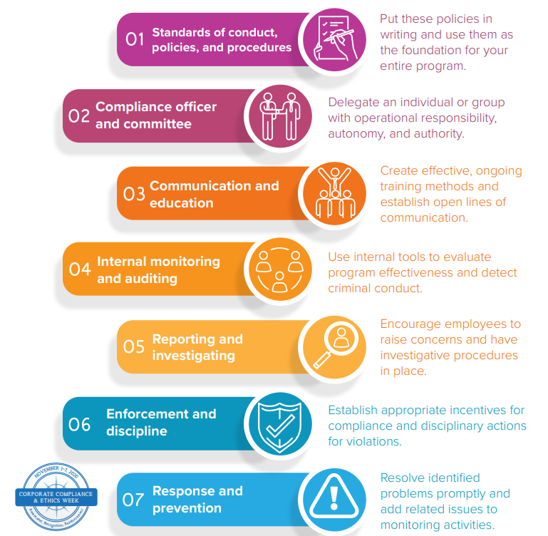
Compliance Workplan and Elements of an Effective Compliance Plan
Our Compliance Workplan is part of having an effective Compliance Program
The Workplan requires compliance with the seven elements of effective compliance programs
The Hospital includes an additional element: Monitoring our 340B pharmacy program

Slide 10
Research Compliance
Compliance Achievements
Implemented Institutional Conflict of Interest in the Conduct of Research policy.
Updated HRPP policy & procedures to include enforcement for noncompliance with COI requirements on research studies.
Collaborations
Co-led effort with Research Technology Program to validate DocuSign as 21 CFR 11 compliant for electronic signatures.
Co-managed externship program with Privacy Team; externs have led many of the 10 DEI sessions presented to Legal, Risk and Compliance staff.
ACCOMPLISHMENTS - YEAR IN REVIEW 2023
Compliance Oversight
Clinical Trials Billing audit completed.
Audited COI disclosures against Open Payments, identifying areas for targeted education and training.
Audited ClinCard payment process and procedures; 92% accuracy rate in making payments to research participants.
Compliance Operations
  Achieved 97% completion rate for annual Conflict of Interest Survey.
  Achieved 80% completion rate for annual IRS 990 Survey.
  Most recent IRS 990 survey launched on 2/29/24.
  Upcoming annual COI survey is planned for April 2024.

Slide 11
Upcoming Initiatives – 2024
Collaborate with Research Finance:
  Audit of Cost Transfer policies, process & sample transactions
  Audit of Procurement activities for Single Audit readiness
Collaborate with Clinical Trial Operations:
  Develop and implement an appropriate Clinical Trials billing monitoring program
Collaborate with Office of Human Research Affairs:
  On the review and, as necessary, remediation from COI Management Plan review findings from Clinical Research Resources Office Quality Assurance Review reports
Conduct program needs assessment of Export Controls Program
Implement more frequent, targeted COI education as well as continued monitoring of Open Payments and BMC COI disclosures
Collaborate with Sponsored Programs Administration:
  On the baseline compliance review of Reported Foreign Affiliations in Other Support & Biosketch forms

Slide 12
Upcoming 2024 Conflict of Interest Survey
Annual Disclosure of Outside Interests: Launch planned for 1st week of April 2024
Audience:
    Trustees, Officers, Directors & Senior Management
    WellSense Health Plan employees
    Providers
    Investigators & Key Research Personnel
    Office of the General Counsel and Compliance Department
    Members of committees who may influence purchasing or formulary decisions
    Supply Chain and Value Analysis Team

Slide 13
Other Contact Information
Compliance Department
DG-ComplianceHelp@BMC.org
Compliance Hotline (800-586-2627)
Research Compliance
DG-Research_Compliance@BMC.org
COI-Compliance@BMC.org
https://hub.bmc.org/departments/compliance/research-compliance
617-638-7954
Jami.Wood@bmc.org

Slide 14
BMC Research Informatics
& the Clinical Data Warehouse for Research (CDW-R)
Melissa Hofman, MSIS
Director, Research Informatics

Slide 15
BMC Research Informatics

Slide 16
BMC Research Informatics
BMC Research Informatics serves as a centralized entity to support the BUMC research community in research data strategy and infrastructure by leading optimization efforts to improve data quality and implementing innovative strategies to leverage research-quality data that support the institution’s broad research goals.
Notes:
Established 202X???
Under office of CSO

Slide 17
Supporting the BUMC research community in research data strategy and infrastructure
System
Environments
Research Data Infrastructure
Collaborate with BMC Research Technology Program (RTP) on IT and system environments, Epic research functionality, software integrations, and vendor management.
Design and develop optimal data workflows, curation, storage, and extraction.
Informatics
Research Data Services Administration
Translate research data needs into innovative solutions and systematic data systems, optimizing efforts to improve data quality and implementing innovative strategies to leverage research-quality data (natural language processing, phenotyping, algorithms, pivoting data, Epic smart tools).
Develop and maintain analyst standard operating procedures, data documentation, and core facility billing policies and practices.
Increase data literacy among BUMC research community through training, education, and resources on research clinical data collection, documentation, manipulation, transformation, and use.
Research Data
BMC Research Informatics
Scope of Work
Facilitate researcher access to EHR, CHC, claims, and external data sources.
Manage the BMC Research Data Warehouse (CDW-R), a Research Core Facility that supports provide data sets extractions, recruitment lists, cohort lists, and simple counts information to BUMC research teams.
Research Data
Governance
Collaborate with IRB, regulatory, compliance, privacy, legal, and operations to develop and document permissible research data access policies and ensure streamlined, appropriate research data access workflows.

Slide 18
BMC Research Informatics
Megan Bair-Merritt, MD, MSCE
Vice President & Chief Scientific Officer, BMCHS
Jake Nudel, MD
Per Diem Clinical Data Scientist
Tina DaSilva, CRA
Executive Director, Research Operations
Melissa Hofman, MSIS
Director, Research Informatics
Per Diem Data Architect/Engineer
BMC Research Informatics
BMC CDW-R Core Facility
Erin Ashe, MPH
1.0 FTE Program Director
Emily Davis
1.0 FTE Research Informatics Systems Analyst
Kathleen Dwiel, MSPH
0.8 FTE Sr. Clinical Research Data Manager
Linda Rosen, MSEE
1.0 FTE Sr. CDW Data Manager
Raghda Abdalla
1.0 FTE
Project Management Specialist
Priya Gupta, MHI
1.0 FTE Clinical Research Data Analyst
Manasee Godsay, MS
1.0 FTE Clinical Research Data Analyst/Engineer

Slide 19
BMC Clinical Data Warehouse for Research (CDW-R)

Slide 20
BMC Clinical Data Warehouse for Research (CDW-R) – Research Core Facility
Centralized resource to access patient-level and population-level data for research.
CDW-R analysts extract and link data from various health system data streams:
    BMC Epic electronic health record (EHR) data.
    Historical data from legacy clinical systems.
    Community Health Center (CHC) OCHIN
    EHR data.
    BMC WellSense Health Plan claims data.
CDW-R develops algorithms and
phenotypes for identifying patients,
characteristics, and conditions – improving
data capture and consistency.
CDW-R collaborates with Departments,
Divisions, and research groups to increase
research infrastructure and better leverage
data for research.
https://www.bmc.org/research/clinical-data-warehouse-cdw
The CDW-R operates as a BMC Research Core Facility/Shared Service. There is an hourly fee for data extraction services.

Slide 21
CDW-R Core Facility Services
Simple Counts
Recruitment/Cohort Lists
Data Extracts
Provide aggregate counts for study planning, feasibility analysis, and grant/proposal submission.
MRN, DOB, name, contact information, demographics, upcoming appointments, cohort inclusion criteria.
(as permitted by IRB protocol)
Data extracted from the data warehouse for your study cohort, organized for data management and provided in excel files.
(mitigating need for manual chart review)
Custom Reports
Linked Data Extracts
Department- or Division-wide Efforts
Recurring data extractions, automatic prospective reports, and patient snapshots
Data extracted from the data warehouse linked to community health center (CHC) data, claims data, and other external data.
Describe specific patient populations, establish efficient recruitment strategies, and increase infrastructure to better leverage data for research.

Slide 22
Research Informatics
FY24 Accomplishments & Goals

Slide 23
BMC Research Informatics – FY24 Accomplishments
Department
Staffing
Resource
Development
Research Data Infrastructure
Data Request Workflow Optimization
Hired per diem Clinical Data Scientist
Hired per diem Clinical Research Data Architect/Engineer.
Hired full-time project management specialist role
Hired 4th CDW-R data analyst
BMC CY2023 Patient Snapshot
New “Basic vs. Clinical Research” resource
Clinical Trials (Velos) Patient Overview Report for CTO
New ‘CDW-R Tip Sheet’
BMC CDW-R THRIVE data guide – research recommendations
Updated guidance for using, sharing, and securing CDW-R data
Incorporated Minority Health Social Vulnerability Index (SVI) data into Research Data Warehouse (a compliment to the CDC/ATSDR SVI data)
Launched new ‘Simple Counts’ request form
Launched new quote for CDW-R services request form
Launched Calendly for researchers to schedule CDW-R consultations
Notes:
STAFFING

Slide 24
BMC Research Informatics: FY24 Priorities
1
2
Continued to support
CSO Office & Research Operations in research systems and data needs
FY24 Data Migration & Infrastructure Improvement Project

Slide 25
FY24 Data Migration & Infrastructure Improvement Project

Slide 26
BMC Health System is undertaking several data warehouse infrastructure improvement efforts leading up to Fall 2024.
Data Migration Outcomes and Benefits
      Streamline the data request to provision process
      Leverage more secure and efficient technologies for data provisioning
      Increase use of automation and AI to handle complex data requests
      Standardize variables and improve documentation both internally and externally
      This one-time data migration project requires a short-term impact – a ‘downtime’ – on the CDW-R team’s ability to engage with new research data set extraction requests.
      Information on the CDW-R downtime and its impacts are detailed on our website.

Slide 27
For more information…
Visit our website
https://www.bmc.org/research/clinical-data-warehouse-cdw
Email us
cdw@bmc.org

Slide 28
Research Contracts & Industry Agreements (RCIA)
Asa Lopatin
Director, Research Contracts and Industry Agreements

Slide 29
RCIA Team Functions
Contract Negotiation and Execution
Draft, review, and negotiate contracts related to BMC research and research-adjacent programs.
Education, Training, and Consultations
Develop and implement training and guidance resources pertaining to relevant terms and conditions, legal/regulatory requirements, BMC policies and processes, and structure of research collaborations.
Systems and Process Improvement
Provide transparency and customer service to BMC researchers and research administrators.

Slide 30
Activities to Date
Starting in Fall 2023, collected information on relevant policies, SOPs, templates, systems, institutional stakeholders, customer feedback.
Transition majority of contract negotiations in Research Operations to RCIA portfolio, including:
  Data Transfer and Use Agreements
  Material Transfer Agreements
  Non-Funded Collaboration Agreements
  License Agreements
  Limited Service and Programmatic Agreements
  Industry-Sponsored and BMC Investigator-Initiated Clinical Trial Agreements
Advise and consult researchers regarding administrative requirements for pending and in-progress research projects
Begin developing foundation for streamlined intake process and agreement tracker to promote transparency, efficiency

Slide 31
Priority: Managing Contracts Efficiently and Transparently
Balancing Compliance and Efficiency
RCIA is tasked with satisfying the dueling priorities of executing research agreements as quickly as possible while protecting the institution’s interests, shielding BMC from liability, and doing right by our patients.
Improving Transparency
Eliminating the “black box” that is common in research administration by prioritizing responsiveness, both internally and externally, and taking a collaborative approach to working with BMC researchers.
Investing in Systems, Resources, and Relationships
Leveraging increased transparency to identify opportunities to for continued improvement, training, and education.

Slide 32
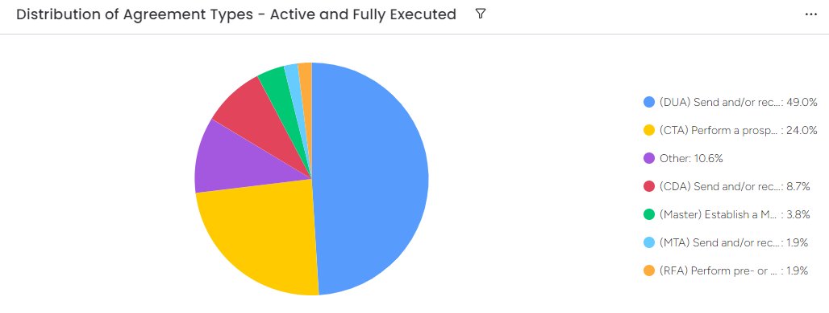
Consolidating and Standardizing Intake and Workflow Tracking
By collecting more detailed data during the agreement request process and tracking review and negotiation timelines in a standardized manner, RCIA can better understand where additional resources need to be devoted.

Slide 33
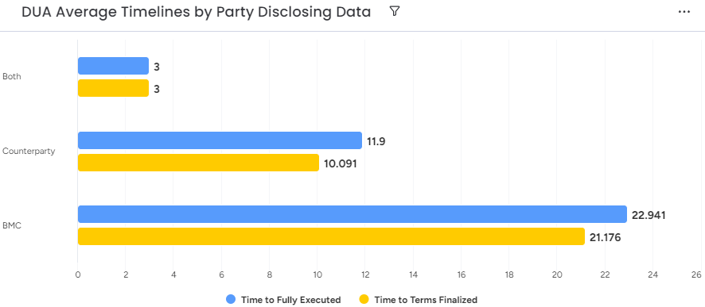
Reducing Negotiation Timelines
On average, it takes nearly twice as long to execute an outgoing DUA as it does to execute an incoming DUA.
Detailed records allow us to identify potential causes as well as opportunities for proactive investments and process improvements.
Where processes can be modified, we will have the information to do so strategically. Where they can’t, we can develop appropriate training materials.

Slide 34
Initiatives for 2024
Consolidate Agreement Request Intake Processes
Standardize request process for agreements handled by RCIA to reduce confusion caused by large number of discrete forms and workflows.
Refine Tracker for Negotiations and Active Agreements
Continue to evaluate available options and build system capable of providing accessible updates and meaningful data.
Expand Training and Guidance Resources
Identify priorities for additional training opportunities, reference materials, and strategic partnerships.

Slide 35
Thank you!
Asa Lopatin, JD, Director, Research Contracts & Industry Agreements
Asa.Lopatin@bmc.org

Slide 36
Research Service Centers
Douglas Rockwell

Slide 37



Research Service Centers
Shared Resources
Core Facilities
BU Shared Services
Sponsored Programs Support Services
BMC Clinical Data Warehouse (CDW) for Research
Laboratory and Biorepository Research Services Core
Radiology Core

Slide 38




Sponsored Programs Support Services
Tools
Training
Information
Business Partner

Slide 39

Sponsored Programs Support Services
FINANCIAL SUPPORT
    JIT
    Account financial oversight
    Budget and Cost monitoring & tracking
    Salary allocations
    Payments
    Purchasing
    Job Posting
Business Partner

Slide 40
Research Service Centers
IDEA
THOUGHT
QUESTION
COMMENT

